Slide 1
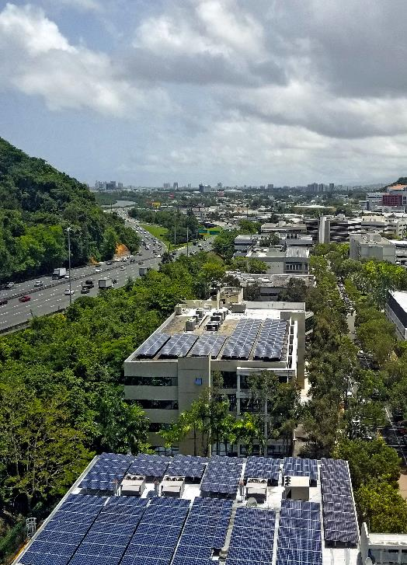

How to widely deploy and make solar energy last ?
Webinar
INTERNATIONAL AID & HEALTH SECTOR
January 17, 2023
Notes:
Thank you for being with us today. The webinar will start soon. We are just waiting for a few more people to join.
--
Thank you for being with us today. Welcome to this ClImate action accelerator webinar.
My name is Marie-Flore Michel and I am Team Leader of the Solutions Unit at the Climate Action Accelerator
Today, we will try to answer the question: how to widely deploy and make solar energy last ?

Slide 2

Practical information
PROGRAMME
1:00 PM | CAA Introduction
1:15 PM | Presentation by Jim Ansara, Co-Founder & Managing Director, Build Health International (BHI)
1:40 PM | Presentation by John Keane, CEO, SolarAid
2:00 PM | Questions & Answers, moderated by CAA
This webinar is recorded and will be made available on replay on our website.
Please keep your audio and video off at all time, unless you are given the floor by the CAA moderator during the Q&A session.
To ask a question, please write in the chat or raise your hand. The moderator will read questions and give the floor to attendees during the Q&A session.
Our website: https://climateactionaccelerator.org/events/webinar_how_to_widely_deploy_and_make_solar_energy_last/
Notes:
To discuss this issue, we are very honoured to have with us today Jim Ansara from Build Health International and John Keane from Solar Aid. Before moving to their presentations, I will give a short introduction. And in the end we will have around 30minutes for questions and answers,
Today we mainly have attendees from aid and health organisations – and also energy experts.
-- some practical information for you before starting,
This webinar is recorded and will be made available on replay on our website.
Please keep your audio and video off at all time, unless you are given the floor by the CAA moderator during the Q&A session.
To ask a question, please write in the chat or raise your hand. The moderator will read questions and give the floor to attendees during the Q&A session.

Slide 3

An important reminder
Notes:
I always like to start with an important reminder. Why are we putting so much efforts in changing our business as usual practices ?
The scientists have been very clear and have reminded us multiple times of the global climate emergency.
Just to mention a few facts here that I am sure some of you already have in mind. Half the world's population live in contexts that are highly vulnerable to climate change. Extreme weather events like floods, droughts or storms are already increasing and will intensify in the coming years, with adverse consequences on people including deaths. Water and food security is threatened, especially for the most vulnerable ones. And all these impacts are aggravated by poverty,
So, coming back to our graph here. The scientists are warning us that we are not on the right track. They call for a "rapid and radical " reduction in greenhouse gases emissions because our decisions today can ensure a livable future for us and for the next generations. The aid and health sectors are of course not the main emitters, but we all have a role to play in this great societal change.

Slide 4
Our objectives
Who are we?
EMPOWER
Empower organizations to at least halve their emissions by 2030 through a hub of expertise and resources.
The Climate Action Accelerator is a non-profit initiative based in Geneva that aims to mobilize a critical mass of community-based organisations around the world to scale up implementation of climate solutions, keep global warming well below 2°C and avoid the risk of dangerous drift.
The goal is to help move the aid, health and higher education sectors towards a radical transformation of their practices, pursuing emission reduction targets (-50% by 2030) and a 'net zero' trajectory, in line with the Paris Agreement.
CHAMPION
Transform them into ambassadors of change within their networks, capable of influencing their peers.
COMMUNITY
Build a global community of action, sharing climate solutions as a universal common good, to scale up their deployment.
Notes:
The Climate Action Accelerator (CAA) is a non-profit organisation based in Geneva,
Which aims to scale up climate action within the international aid sector first, and then the health sector.
The CAA support its partner organisations towards a radical transformation of their practices, enabling them to halve their emissions by 2030.
Our key levers:
- a pool of expertise and resources to empower organisations to reduce their emissions
- the transformation these organisations into ambassadors of change, representing good examples for other organisations wishing to engage in a similar approach
- the development of a global community of action, a network

Slide 5












Our partners
16 aid organisations have joined the Climate Action Accelerator and committed to reducing their emissions by 50% by 2030. They benefit from operational support and a dedicated resource center, increased public engagement and visibility, and a chance to inspire a greater domino effect in society.
CAA is an official partner of the UNFCCC's Race to Zero, which allows us to link our operational work to the global climate agenda and integrate our partner organizations into the global effort towards a net-zero sustainable future.
Notes:
We are not alone in this. 16 aid organisations have joined the climate action accelerator and have committed to drastically reducing their emissions.
They benefit from the close support of the CAA in building their environmental roadmap and action plans.
We are also an official partner of the RAce to Zero initative of the United Nations Framework Convention on Climate Change.

Slide 6
Why Solar Energy ?
GREENHOUSE GAS EMISSIONS PER 1 KWH OF ELECTRICITY PRODUCED (ADEME)
Nuclear → 6 g CO2-eq / kWh
Hydropower → 12 g CO2-eq / kWh
Wind power → 15 g CO2-eq / kWh
Solar photovoltaic energy → 44 g CO2-eq / kWh
Natural gas → 418g CO2-eq / kWh
Fuel oil → 730g CO2-eq / kWh
Coal → 1058g CO2-eq / kWh
AN OPPORTUNITY FOR THE AID & HEALTH SECTORS
11 365 – Number of fuel generators used by six UN organizations and ICRC
​
Notes:
80% of the world energy comes from fossil fuels (coal, oil and gas), responsible for most emissions.
When you look at greenhouse emissions per 1 KWH of electricity produced, you clearly see the difference with renewables. Within the renewable sources of energy, solar represents a big opportunity, especially in the aid and health sectors.
Whether it is for headquarters, field infrastructure or emergency operations, aid organisations consume energy mainly from fossil fuels. However, alternatives exist in many cases.
Replacing genetors by solar photovoltaic energy significantly reduces the carbon footprint, as well as the dependence on fossil fuels and generators. Production of solar energy is now facilitated by companies offering technical support, And that is what we are going to discuss today with our guests,

Slide 7
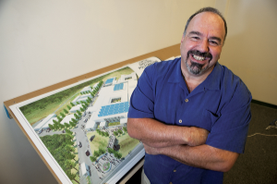
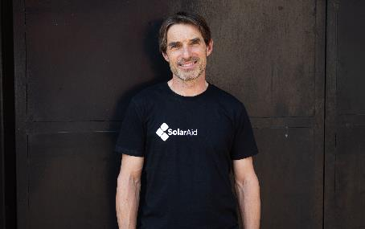
Our speakers today
Jim Ansara, Co-Founder & Managing Director, Build Health International (BHI)
John Keane, CEO, Solar Aid
Notes:
Build Health International (BHI partners with global health non-profits working in fragile health systems to develop infrastructure solutions that elevate the quality and accessibility of healthcare worldwide
SolarAid is an international charity founded in 2006 to fight poverty and climate change. SolarAid provides access to solar lamps in Malawi and Zambia through the social enterprise SunnyMoney, which was established in 2008

Slide 8


Thank you !
Adresse e-mail
contact@climateactionaccelerator.org
https://www.linkedin.com/company/theclimateactionaccelerator/
LinkedIn
Site Web
www.climateactionaccelerator.org
Please connect to our next CAA Webinar on February 28, 2023!

