Slide 1
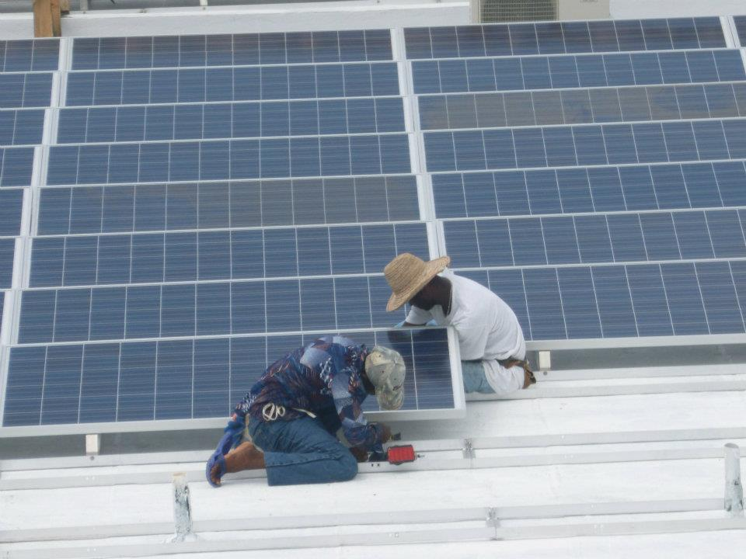

Build Health International
PV Microgrids for Low and Middle-Income Countries

Slide 2
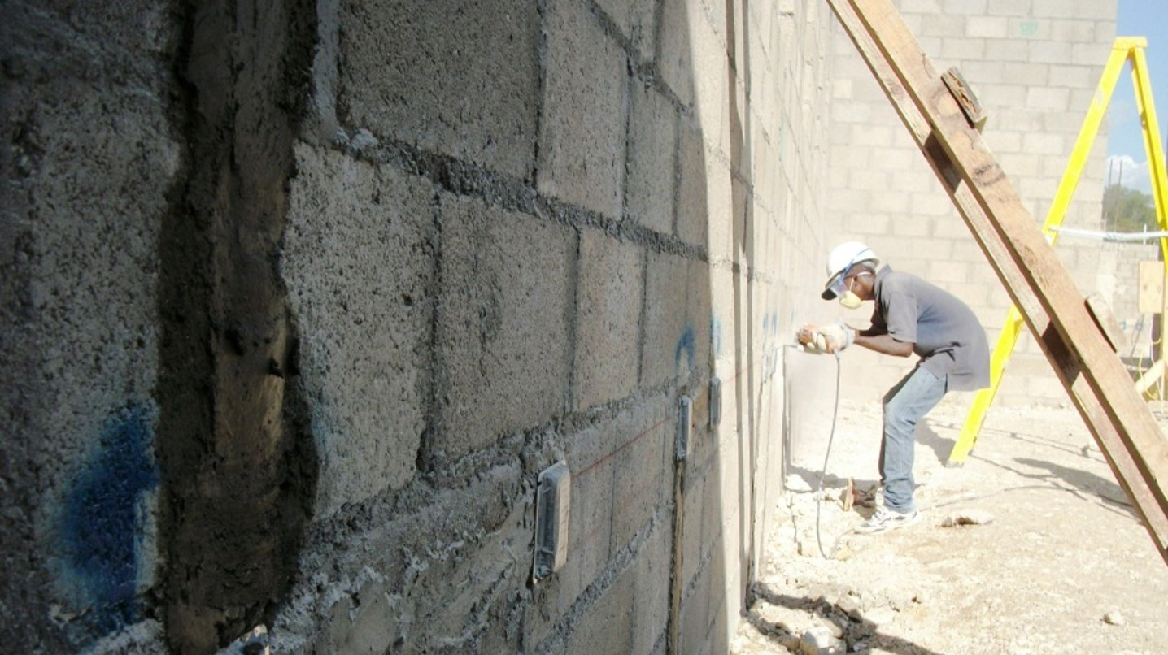

About Build Health International
Build Health International promotes global equity by developing high-quality health infrastructure to enable access to dignified and affordable healthcare in impoverished and resource-constrained regions of the world.

Slide 3
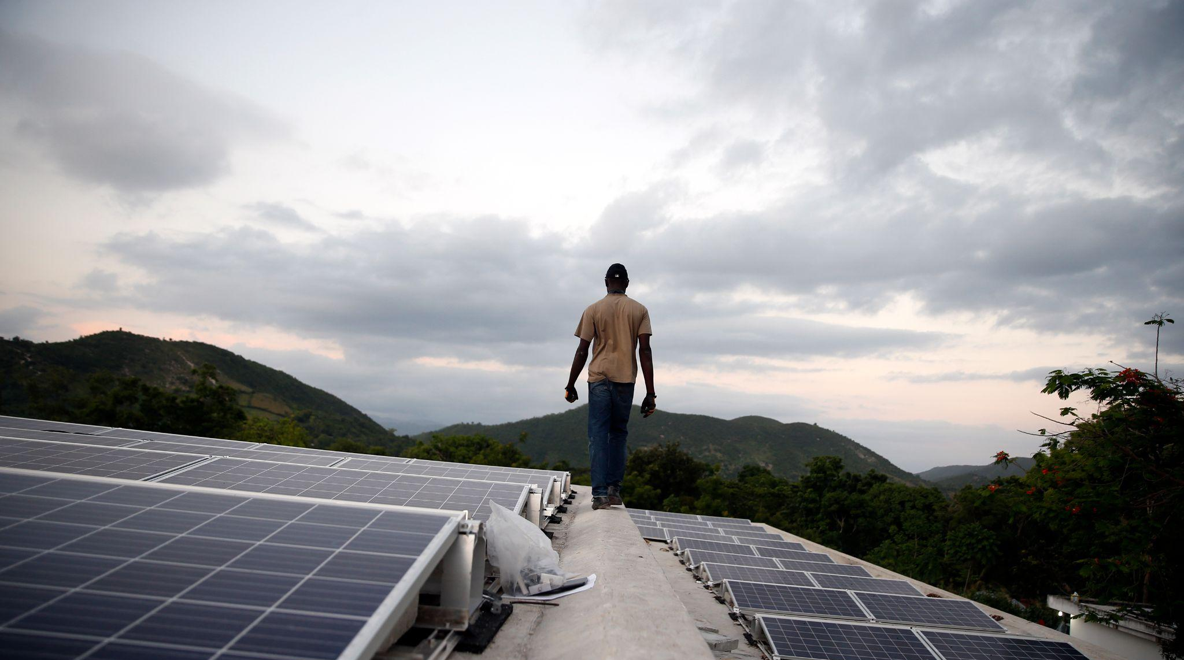
BHI Services for Healthcare Infrastructure
Architecture, engineering, and construction planning for hospitals, clinics, labs, and medical education.
Project management and construction management for select projects.
Purchasing, procurement, logistics, & shipping for medical equipment and specialty construction materials.
Oxygen, medical gas, and biomedical engineering, training, installation, and advisory services.
Research, documentation, and knowledge sharing.
Notes:
BHI's technical team of architects and engineers work in locations such as Haiti and sub-Saharan Africa to create sustainable design, empower communities, and enable access to dignified and affordable healthcare in some of the world’s most vulnerable communities.
Build Health International (BHI) promotes global health equity by developing high quality health infrastructure in low resource settings. Completing over 150 projects in 26 countries, BHI works to understand community challenges and potential opportunities for innovation in resource-constrained settings to be efficient, sustainable and operationally effective. The multidisciplinary team develops new methodologies, approaches, tools and design practices to overcome these challenges in ways that can be replicated across the sector in low-resource settings and emerging markets.
BHI's team of architects and engineers work in locations such as Haiti and sub-Saharan Africa to create sustainable design, empower communities, and enable access to dignified and affordable healthcare in some of the world’s most vulnerable communities.
From clinical planning to architectural design, from building construction to facilities maintenance, BHI provides high-impact NGO, government and private partners with the infrastructure solutions they need to deliver compassionate, dignified healthcare around the world.
Build Health International (BHI) is a design and build nonprofit based in Beverly, MA that develops high-quality healthcare facilities in low-resource settings.
BHI's team of architects and engineers work in locations such as Haiti and sub-Saharan Africa to create sustainable design, empower communities, and enable access to dignified and affordable healthcare in some of the world’s most vulnerable communities.

Slide 4
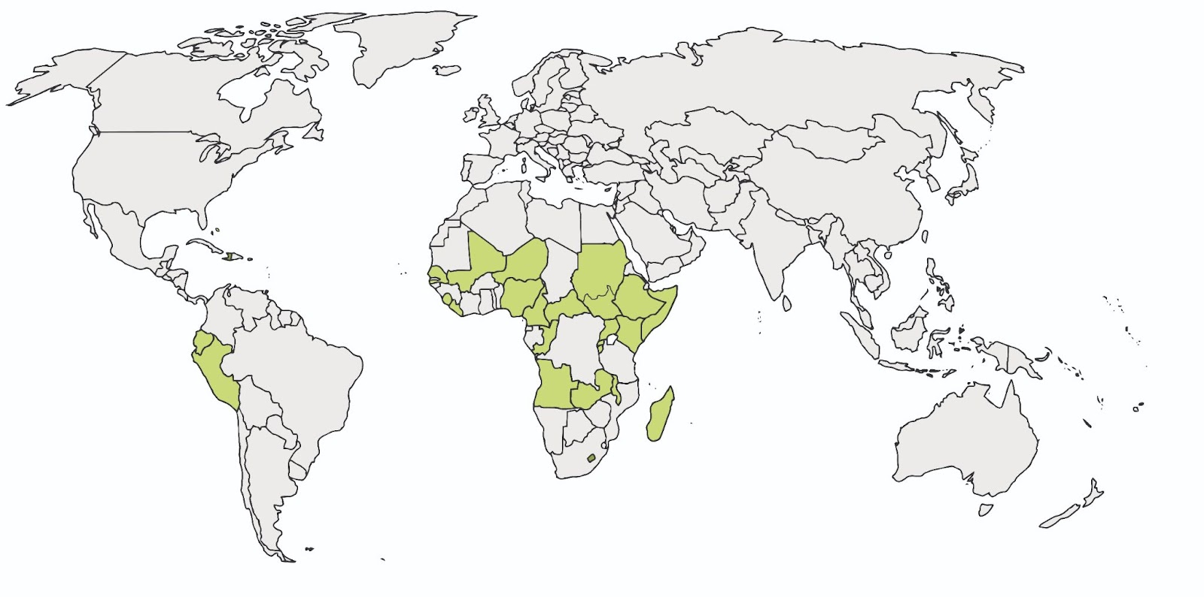
Where We Work
Where we work
Since 2014, BHI has completed over 200 projects. Our global team of architects, engineers and specialists work to understand community challenges to be efficient, sustainable and effective.
Notes:
Our work is increasingly global
While BHI began and continues to be heavily involved in health systems strengthening in Haiti, we have and are continually expanding our breadth

Slide 5
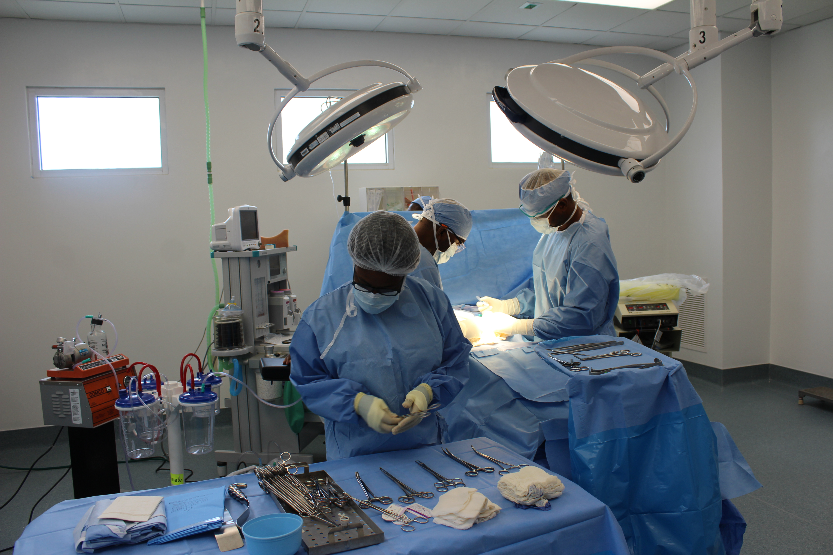
Reliable Electricity is Essential for Care Delivery

Slide 6
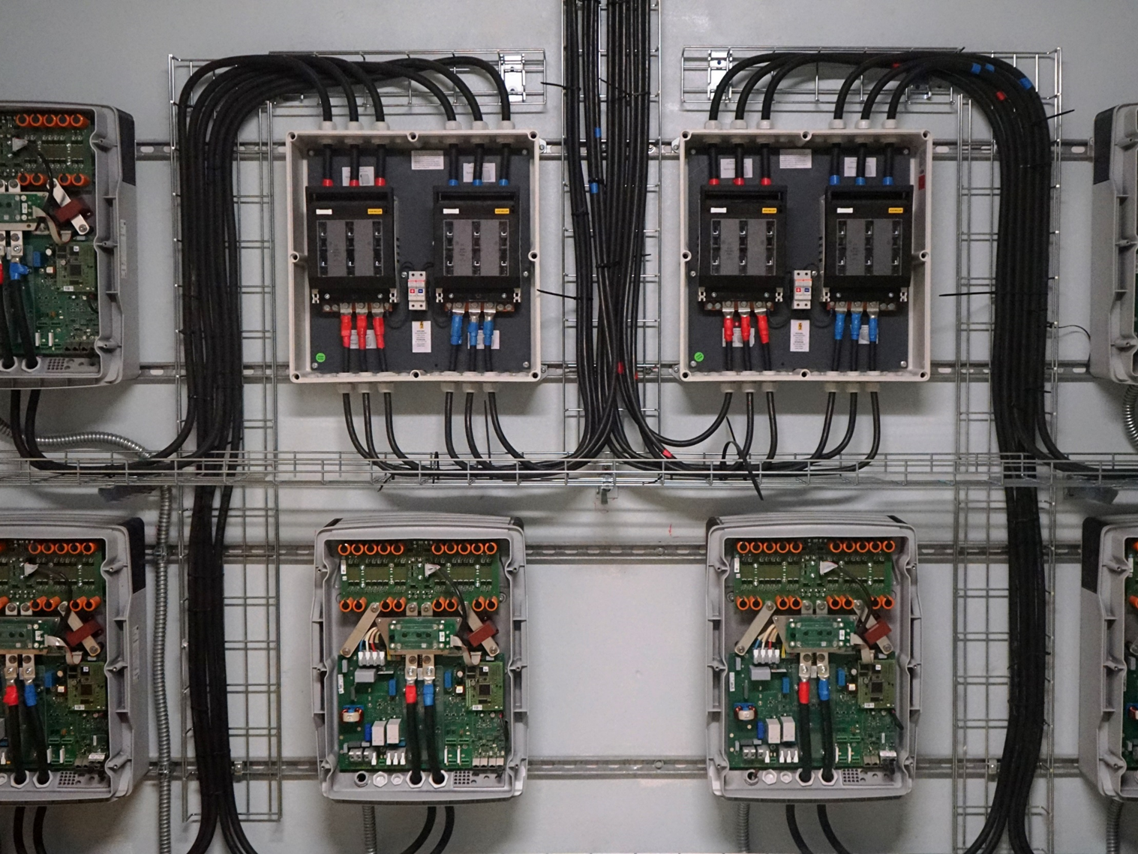
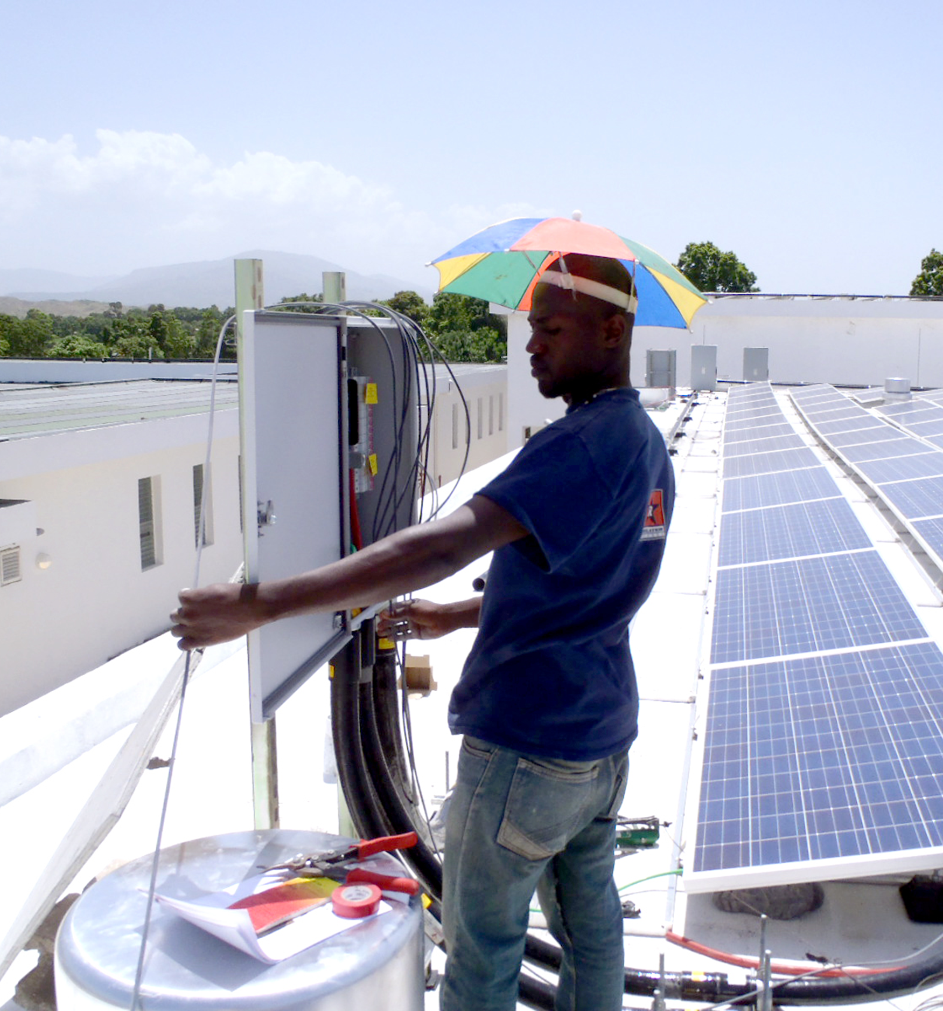
Solar-PV Micro Grid can be a critical strategy to manage operational costs & deliver quality
consistent power.

Slide 7
Baseline for Electrical Energy Systems for Health Care
Energy source must be consistent and dependable.
Quality of electricity must be stable so equipment is not damaged.
Cost per kWH must be affordable given the resources.
There must be redundancy for critical care.
System must be able to be maintained by local resources.
Energy source should have a minimal carbon footprint.

Slide 8
Why BHI focuses on PV Systems
Hydro- is still most cost efficient of renewable systems, but requires optimal conditions, highly specialized construction, and large scale capital investment.
Wind turbines require consistent wind source, very sophisticated maintenance, and large scale capital investment.
PV (photo voltaic) is relatively flexible in terms of location, easily scalable for capital investment, and requires very basic maintenance.

Slide 9
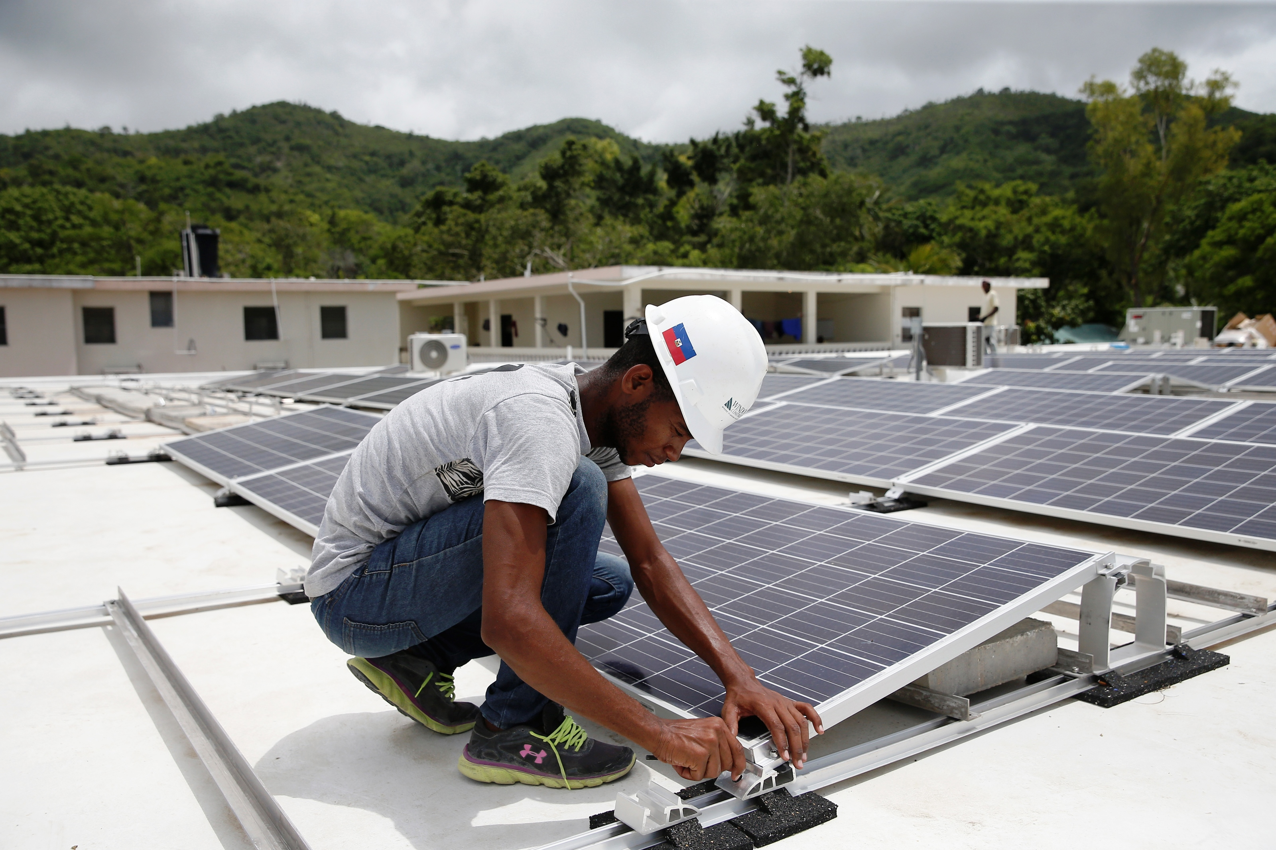

Slide 10
Energy Costs Can Be a Significant Barrier to Care
USA Hospital Expense Model:¹
  Wages and benefits: 56%
  Professional fees: 11.9%
  Other products, such as food, medical equipment, etc. – 11.2%*
  Prescription drugs: 6.7%
  All other: labor intensive: 5.7%
  All other: non-labor intensive: 5.5%**
  Professional liability insurance: 1.2%
  Utilities: 1.8%
Secondary or District Hospital in Haiti Expense Model
¹ Source: “U.S. hospital costs by type of expense in percent 2016”, Frederic Michas 2019

Slide 11
PV Microgrid Design Considerations
Islanded or Grid Tied?
  Grid tied systems require careful study and extensive engineering.
Battery Storage?
  Balance between amount of battery storage/cost vs. percent solar penetration.
BHI is battery manufacturer agnostic.
  Important factors are cost vs. longevity and compatibility with charging and control system.

Slide 12
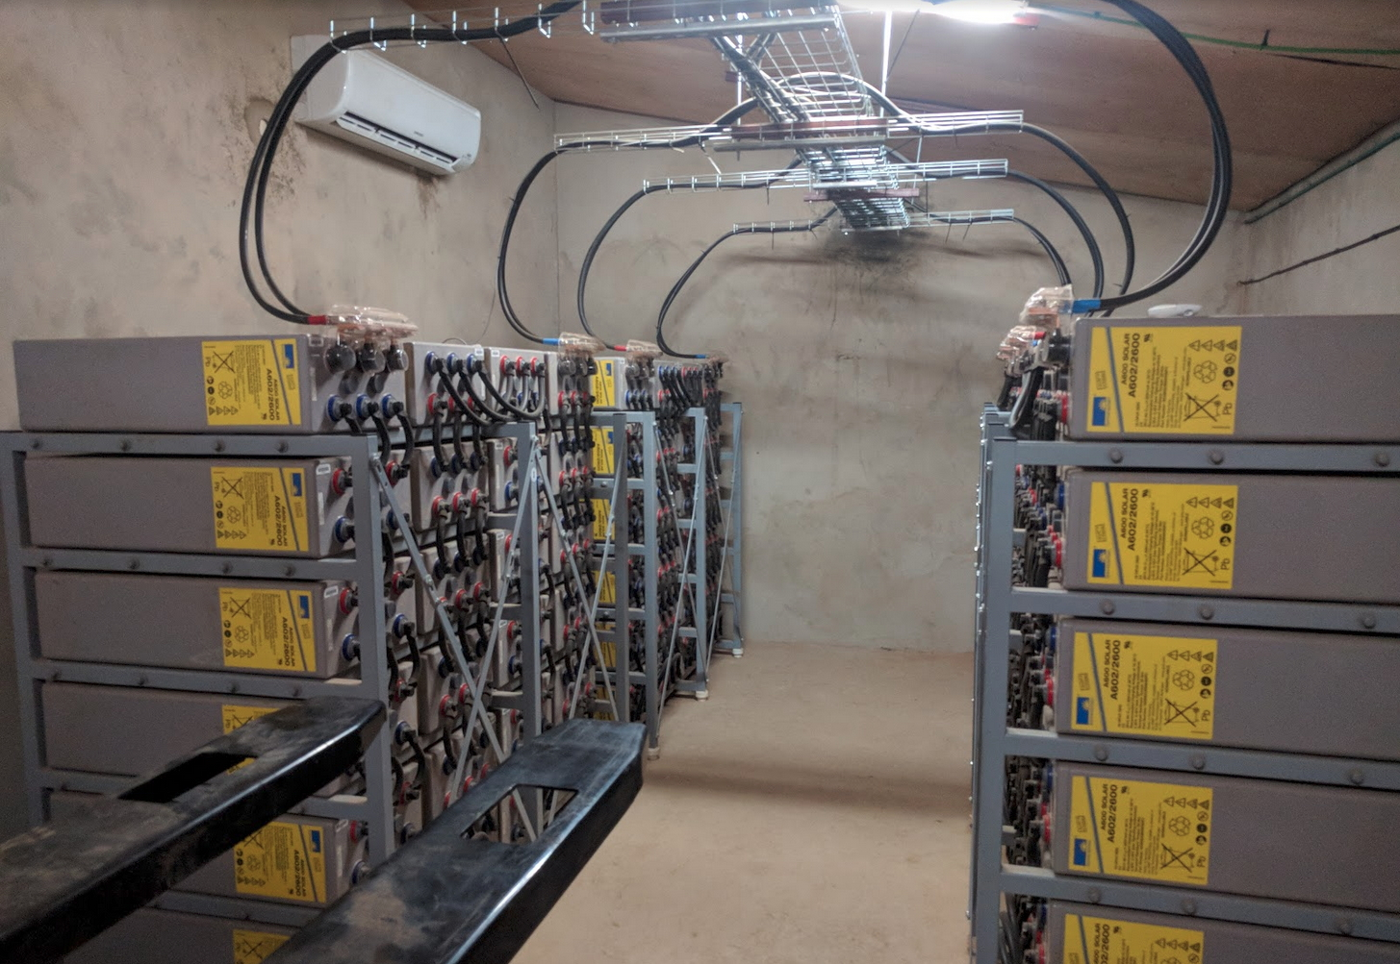
Notes:
Jim and I met through PIH as we came together to build a hospital in Mirebalais.
Not long after the earthquake, we began an ambitious project to build what is now HUM.
From this experience we saw the need for BHI.

Slide 13
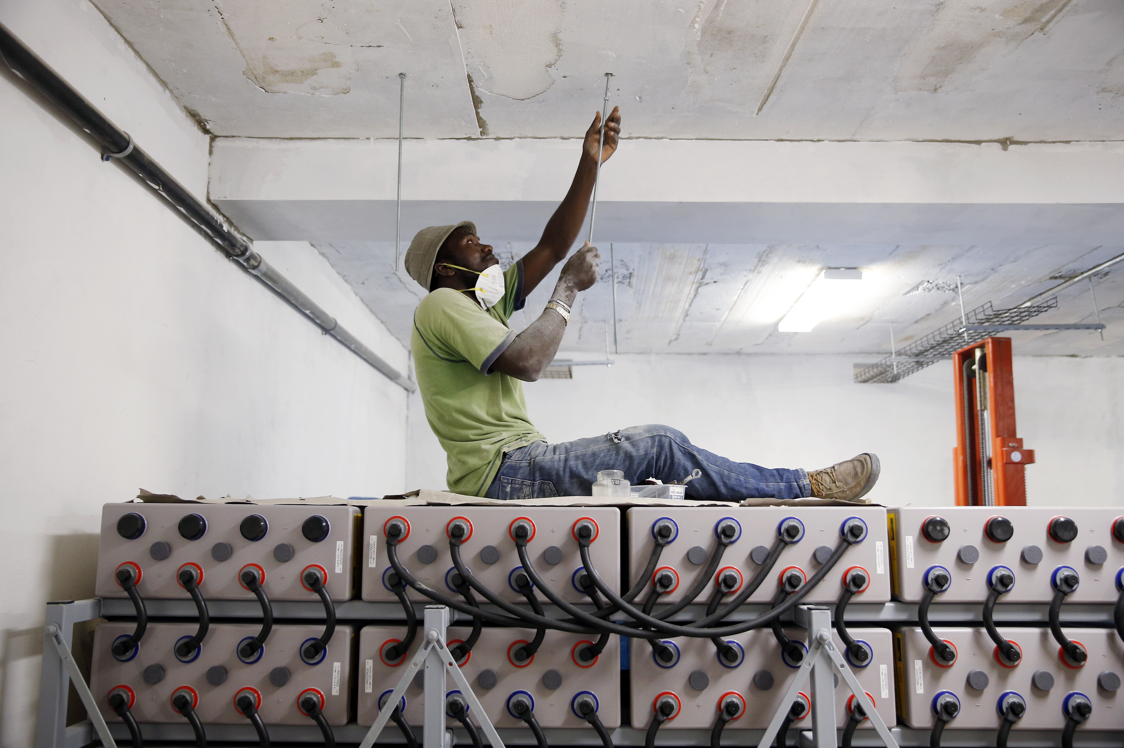

Slide 14
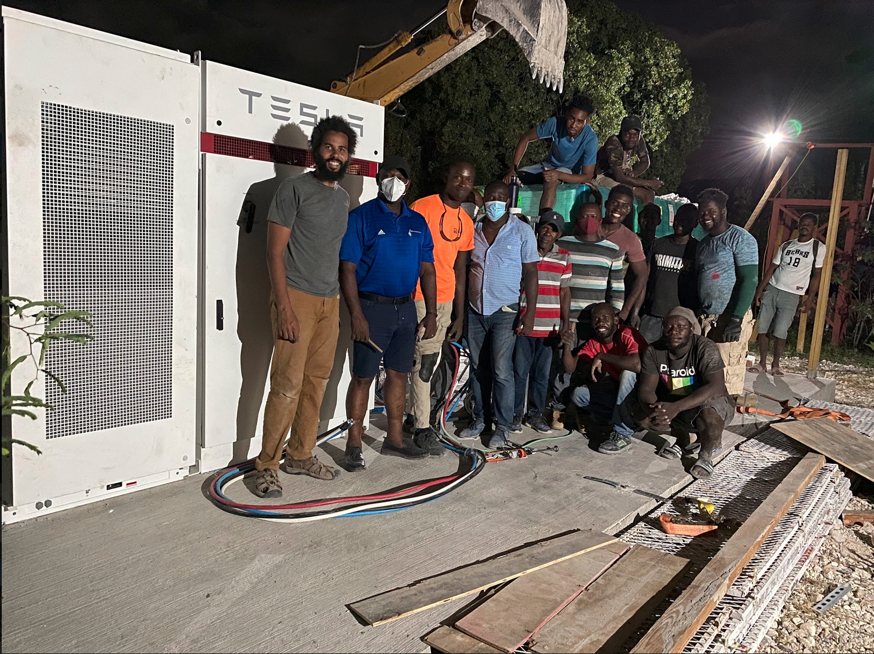

Slide 15
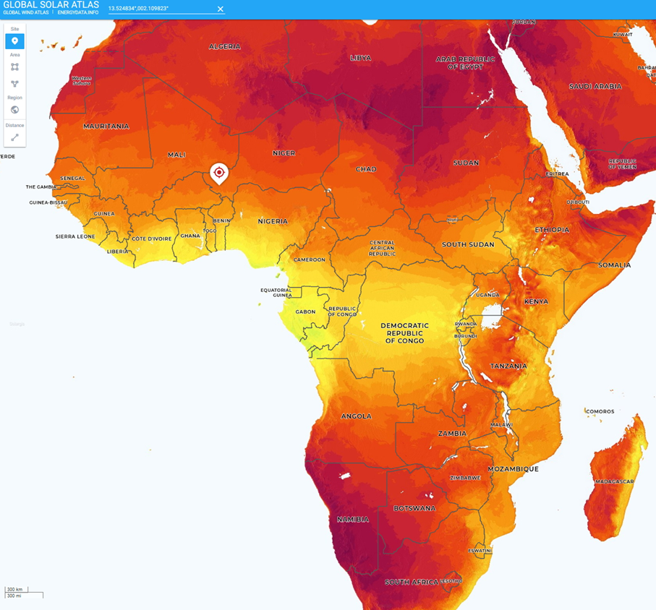
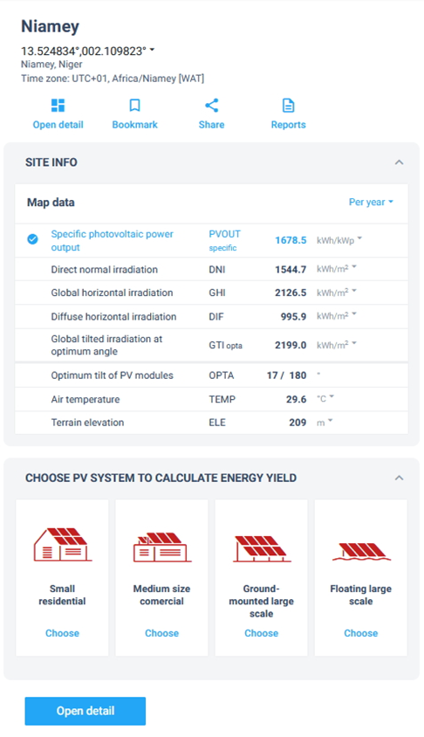
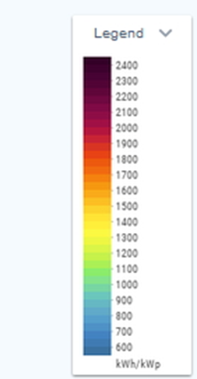
Africa’s Incredible Solar/PV Potential

Slide 16
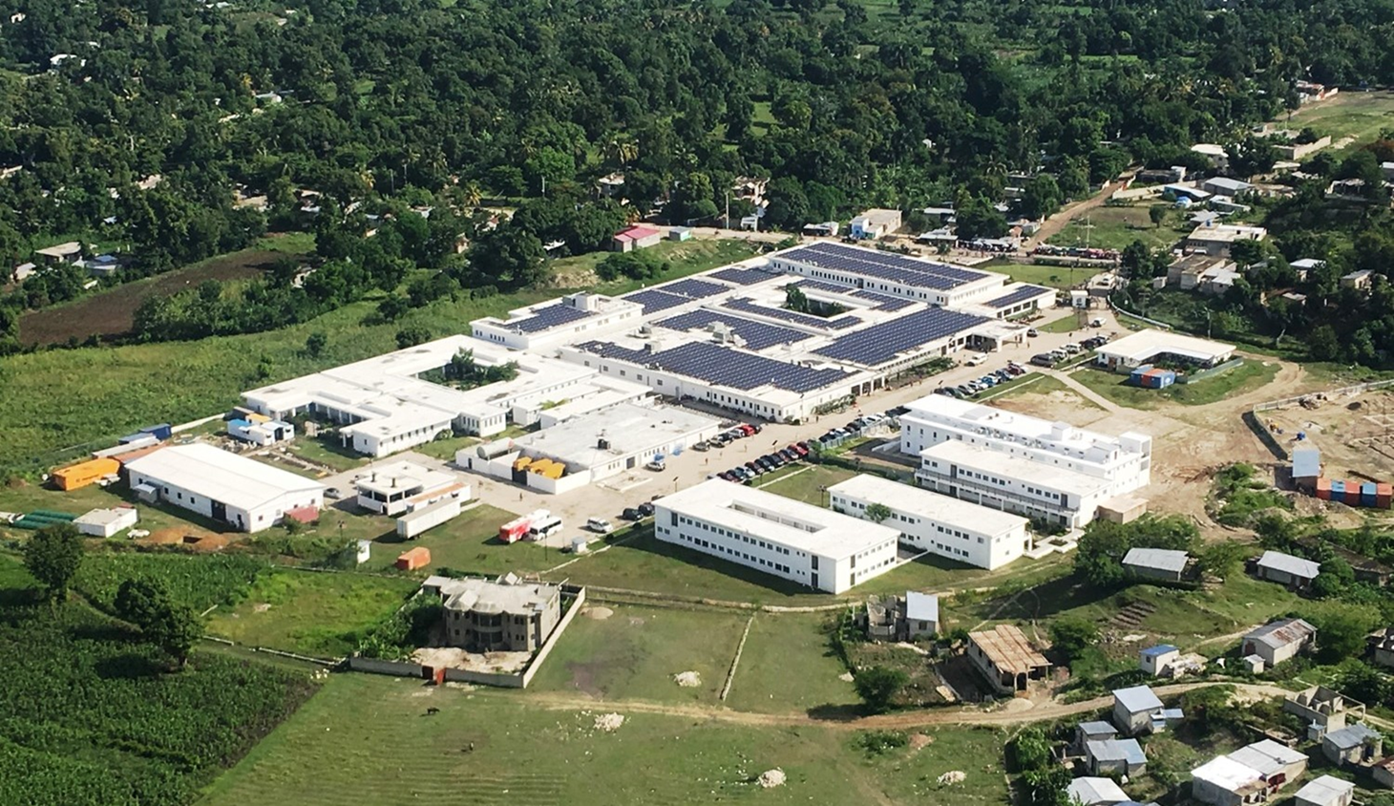
Hôpital Universitaire de Mirebalais (HUM)
Haiti Teaching Hospital: 400 Beds

Slide 17
PV Micro Grid Design Examples:
Islanded with 78% SP
  Islanded system with extensive battery storage
  1,350 kWp of roof mounted PV panels producing avg 5,950 kWh/day.
  2,324 kWh of Tesla lithium ion battery storage with integrated inverter/charger and cooling. 90% DOD. 15 year warranty.
  Anticipated solar penetration with load growth of 78% with diesel gen providing 22%. (Gen set to be optimized by Tesla controller)
  Energy conservation upgrades of $296,500
  System cost per kW, $2,984. Annual cost saving $880,000. ROI- 4.6 years.
  Estimated completion May 2023.

Slide 18
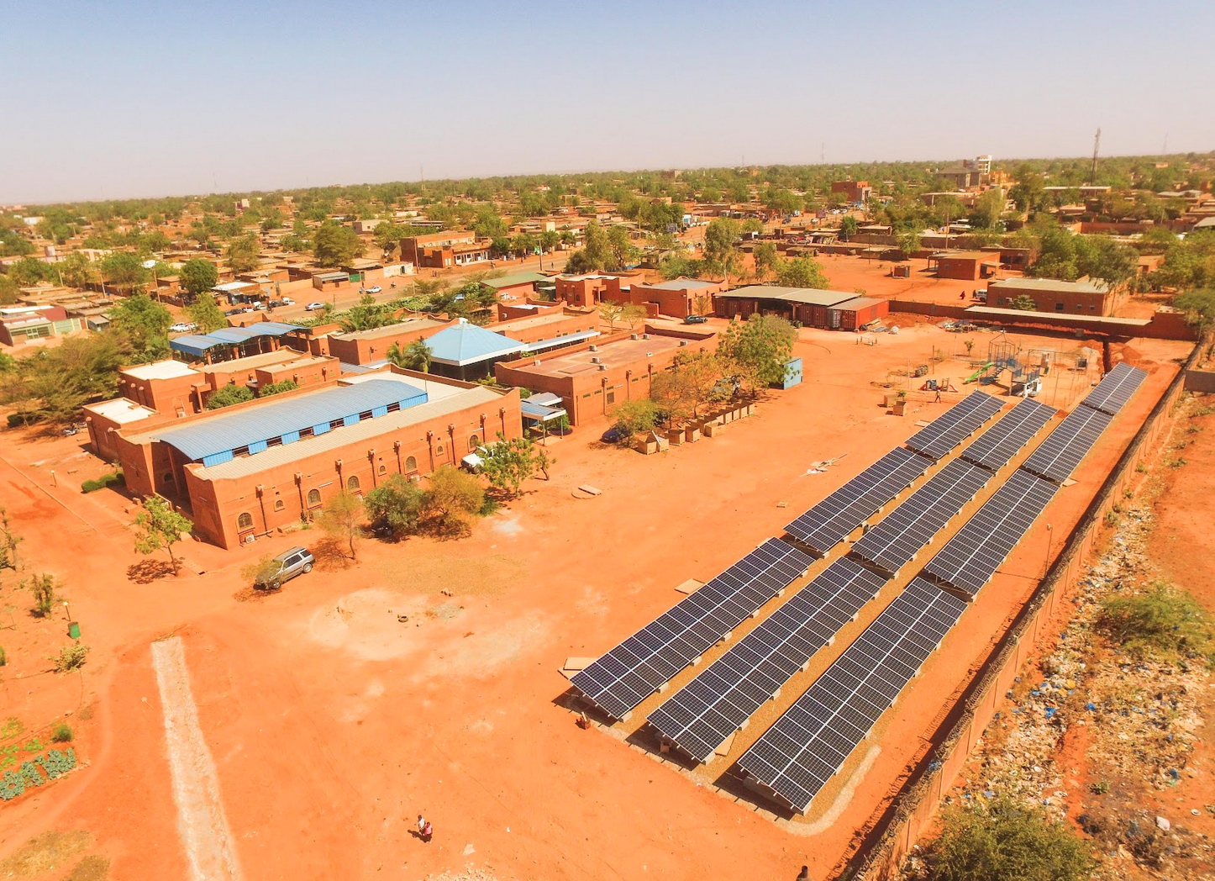

Niger Children’s Pediatric Hospital – 93% SP
Islanded w/ Generator & Grid Back Up
Notes:
Jim and I met through PIH as we came together to build a hospital in Mirebalais.
Not long after the earthquake, we began an ambitious project to build what is now HUM.
From this experience we saw the need for BHI.

Slide 19
Niger Hospital - 93% SP:
Islanded w/ Generator & Grid Back Up
  Children’s Pediatric Hospital: Niger
  Islanded system with battery storage.
  Energy consumption Curve: 85% during day.
    Generator runs 3-4 times per week to top off batteries.
    120 kWp of roof mounted PV panels producing avg 455 kWh a day.
    389 kWh of Sonnenschein gel. 50% DOD. 5 Year Warranty.
  SMA Multi Cluster Inverter/charger.
  System cost per kW, $3,532.
  ROI: 5.2 years
  Completed April 2019.

Slide 20
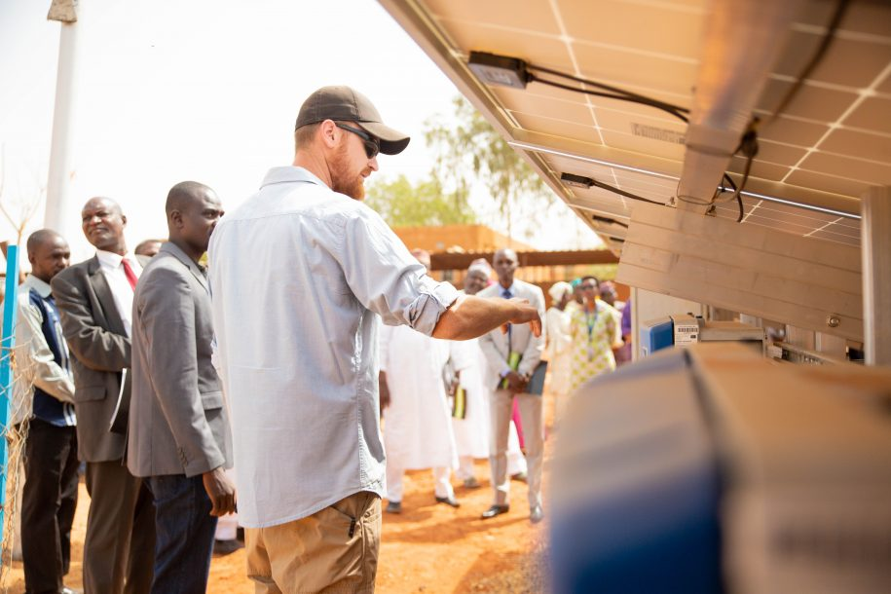
Notes:
Jim and I met through PIH as we came together to build a hospital in Mirebalais.
Not long after the earthquake, we began an ambitious project to build what is now HUM.
From this experience we saw the need for BHI.

Slide 21
Zambia Children’s Hospital
Grid Tied System w/ Battery Storage
  Example of Grid Tied Microgrid
  Islanded system with battery storage.
  System to be charged by both grid & generator.
  237 kWp of ground mounted PV panels producing avg 455 kWh/day.
  Riello hybrid charger/ 250kVA.
  Cegasa Lithium-LFP batteries, 268 kwh. 90% DOD.
  System cost per kW, $2,966.
  ROI- 8.2 years.
  Completion Fall 2023.

Slide 22
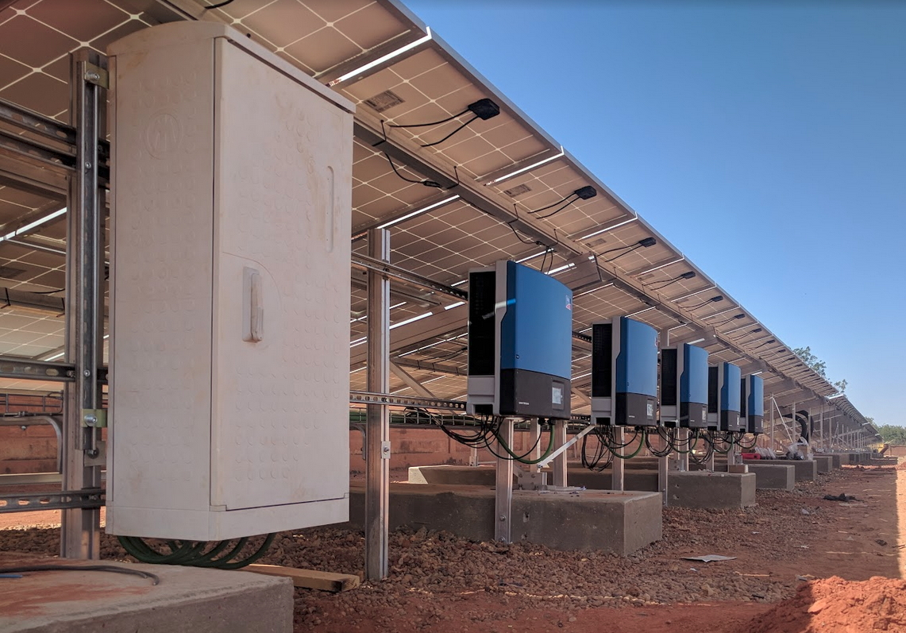
Notes:
Jim and I met through PIH as we came together to build a hospital in Mirebalais.
Not long after the earthquake, we began an ambitious project to build what is now HUM.
From this experience we saw the need for BHI.

Slide 23
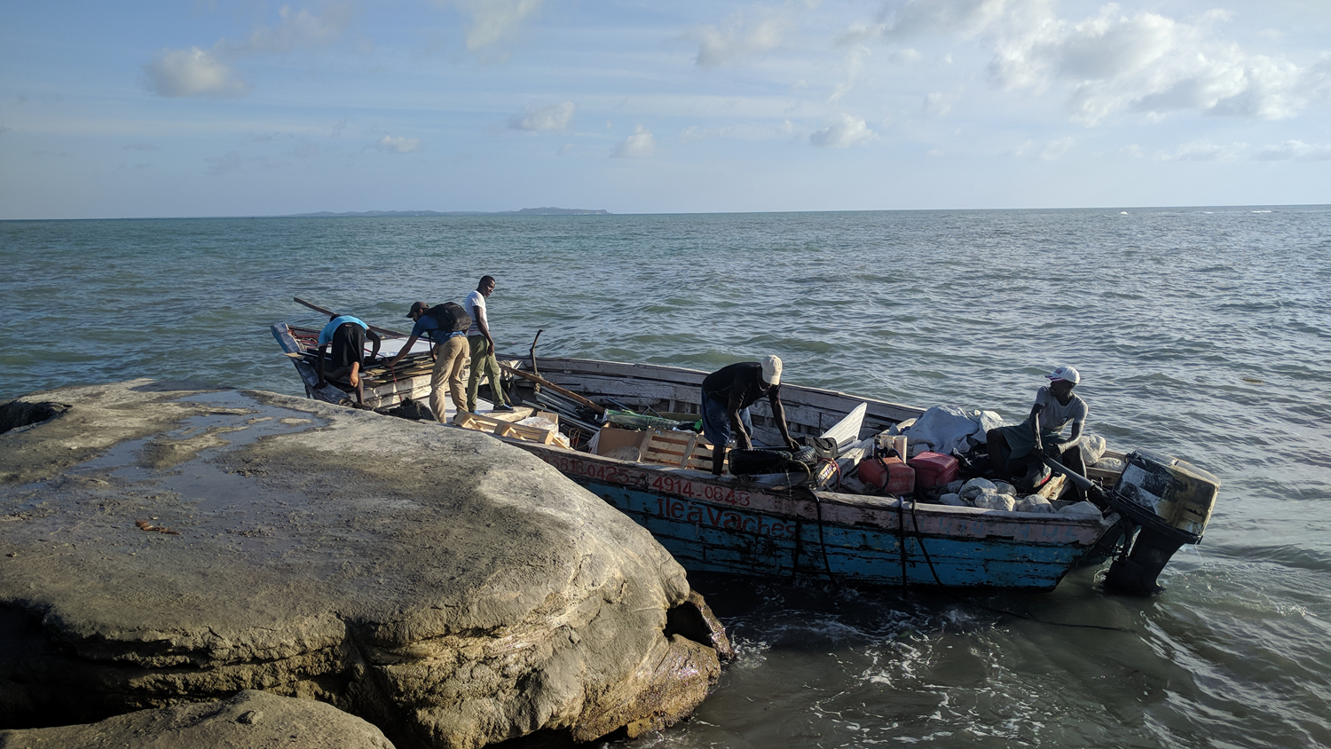
Challenges in Developing LMIC Microgrids

Slide 24
Select Challenges in Developing LMIC Micro-Grids
  Most projects must start with investment in existing electrical infrastructure.
  Finding local or international partners who understand how to design micro-grids in low resource settings is often challenging.
  Properly trained installers can be difficult to source.
  Panel arrays & battery banks must be properly designed for hash environmental conditions.
  Capital is scarce and hard to raise despite the rapid ROI.

Slide 25
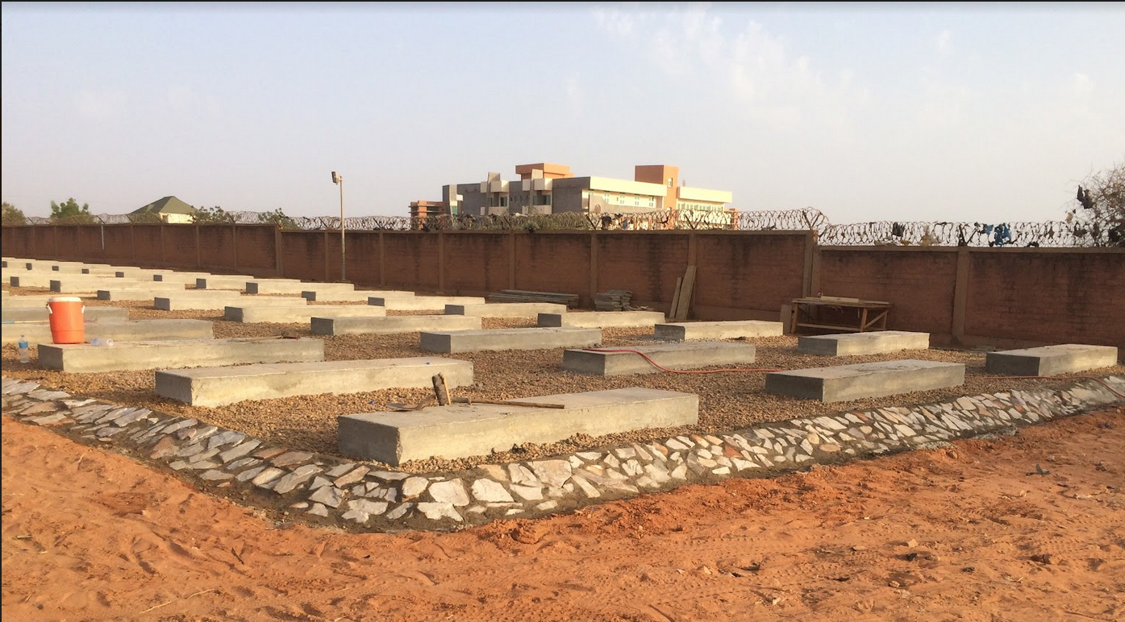
Notes:
Jim and I met through PIH as we came together to build a hospital in Mirebalais.
Not long after the earthquake, we began an ambitious project to build what is now HUM.
From this experience we saw the need for BHI.

Slide 26
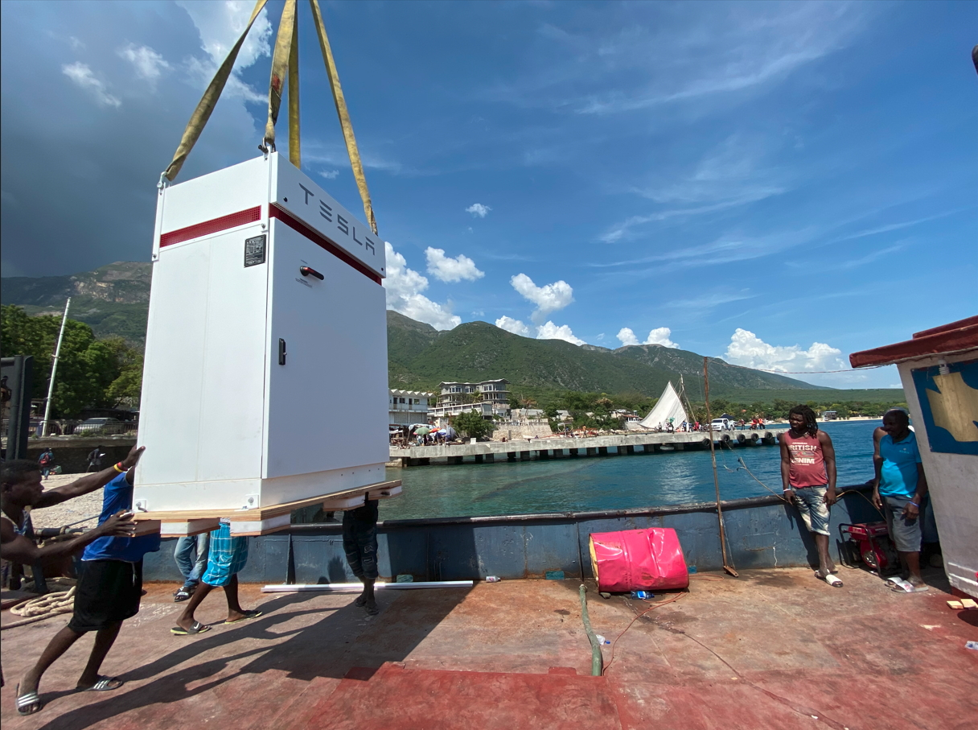
Notes:
Jim and I met through PIH as we came together to build a hospital in Mirebalais.
Not long after the earthquake, we began an ambitious project to build what is now HUM.
From this experience we saw the need for BHI.

Slide 27
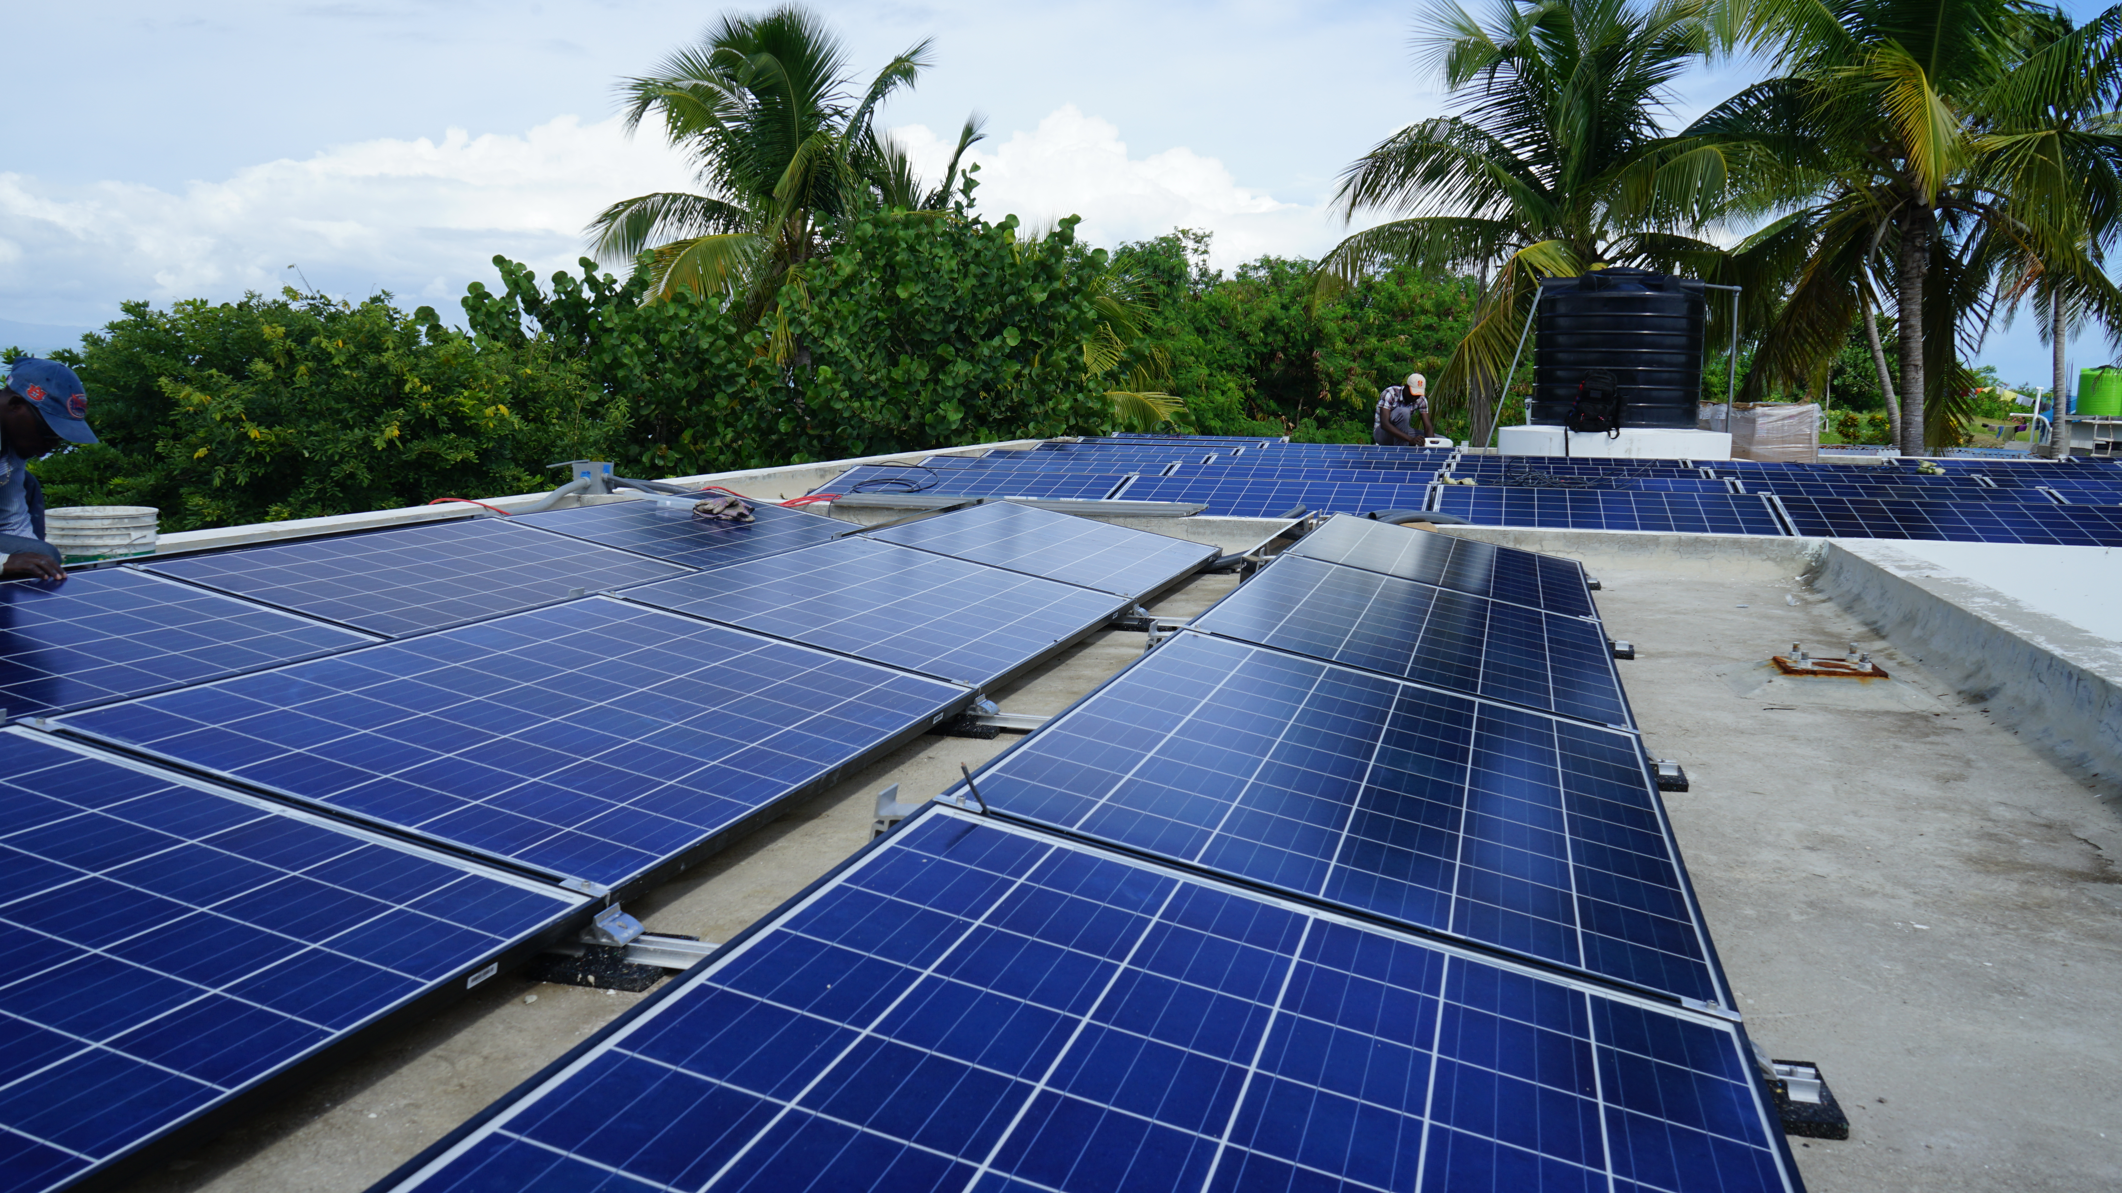
BHI Best Practices for Success

Slide 28
BHI Best Practices for Micro-Grid Development in LMIC’s
Start with energy conservation before embarking on PV.
100% Solar penetration is still not cost effective.
First fix the electrical infrastructure- don’t invest in PV without it
Anticipate and plan for growth in overall electrical load after project.
Batteries and inverters must be in environmentally-controlled spaces.
Look carefully and realistically at lifespan of batteries.
  Be conservative on discharge depths.
Pay attention to matching batteries with inverters/chargers.
Do not move ahead without a long term strategic energy plan.

Slide 29
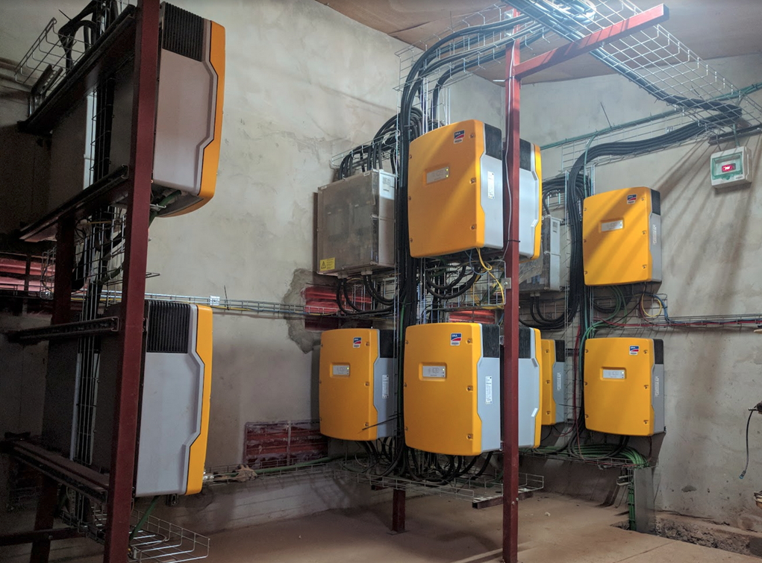
Notes:
Jim and I met through PIH as we came together to build a hospital in Mirebalais.
Not long after the earthquake, we began an ambitious project to build what is now HUM.
From this experience we saw the need for BHI.

Slide 30
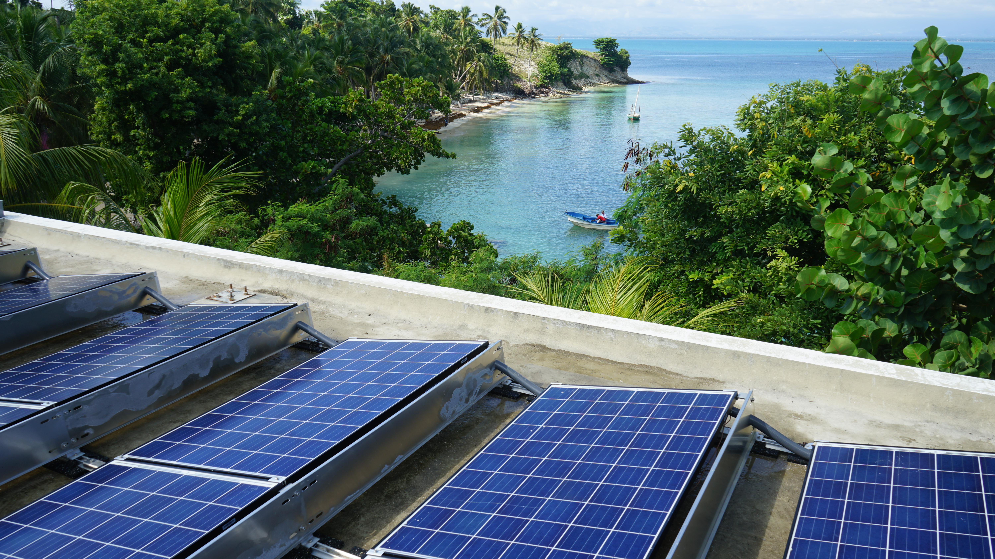
Notes:
Jim and I met through PIH as we came together to build a hospital in Mirebalais.
Not long after the earthquake, we began an ambitious project to build what is now HUM.
From this experience we saw the need for BHI.

Slide 31
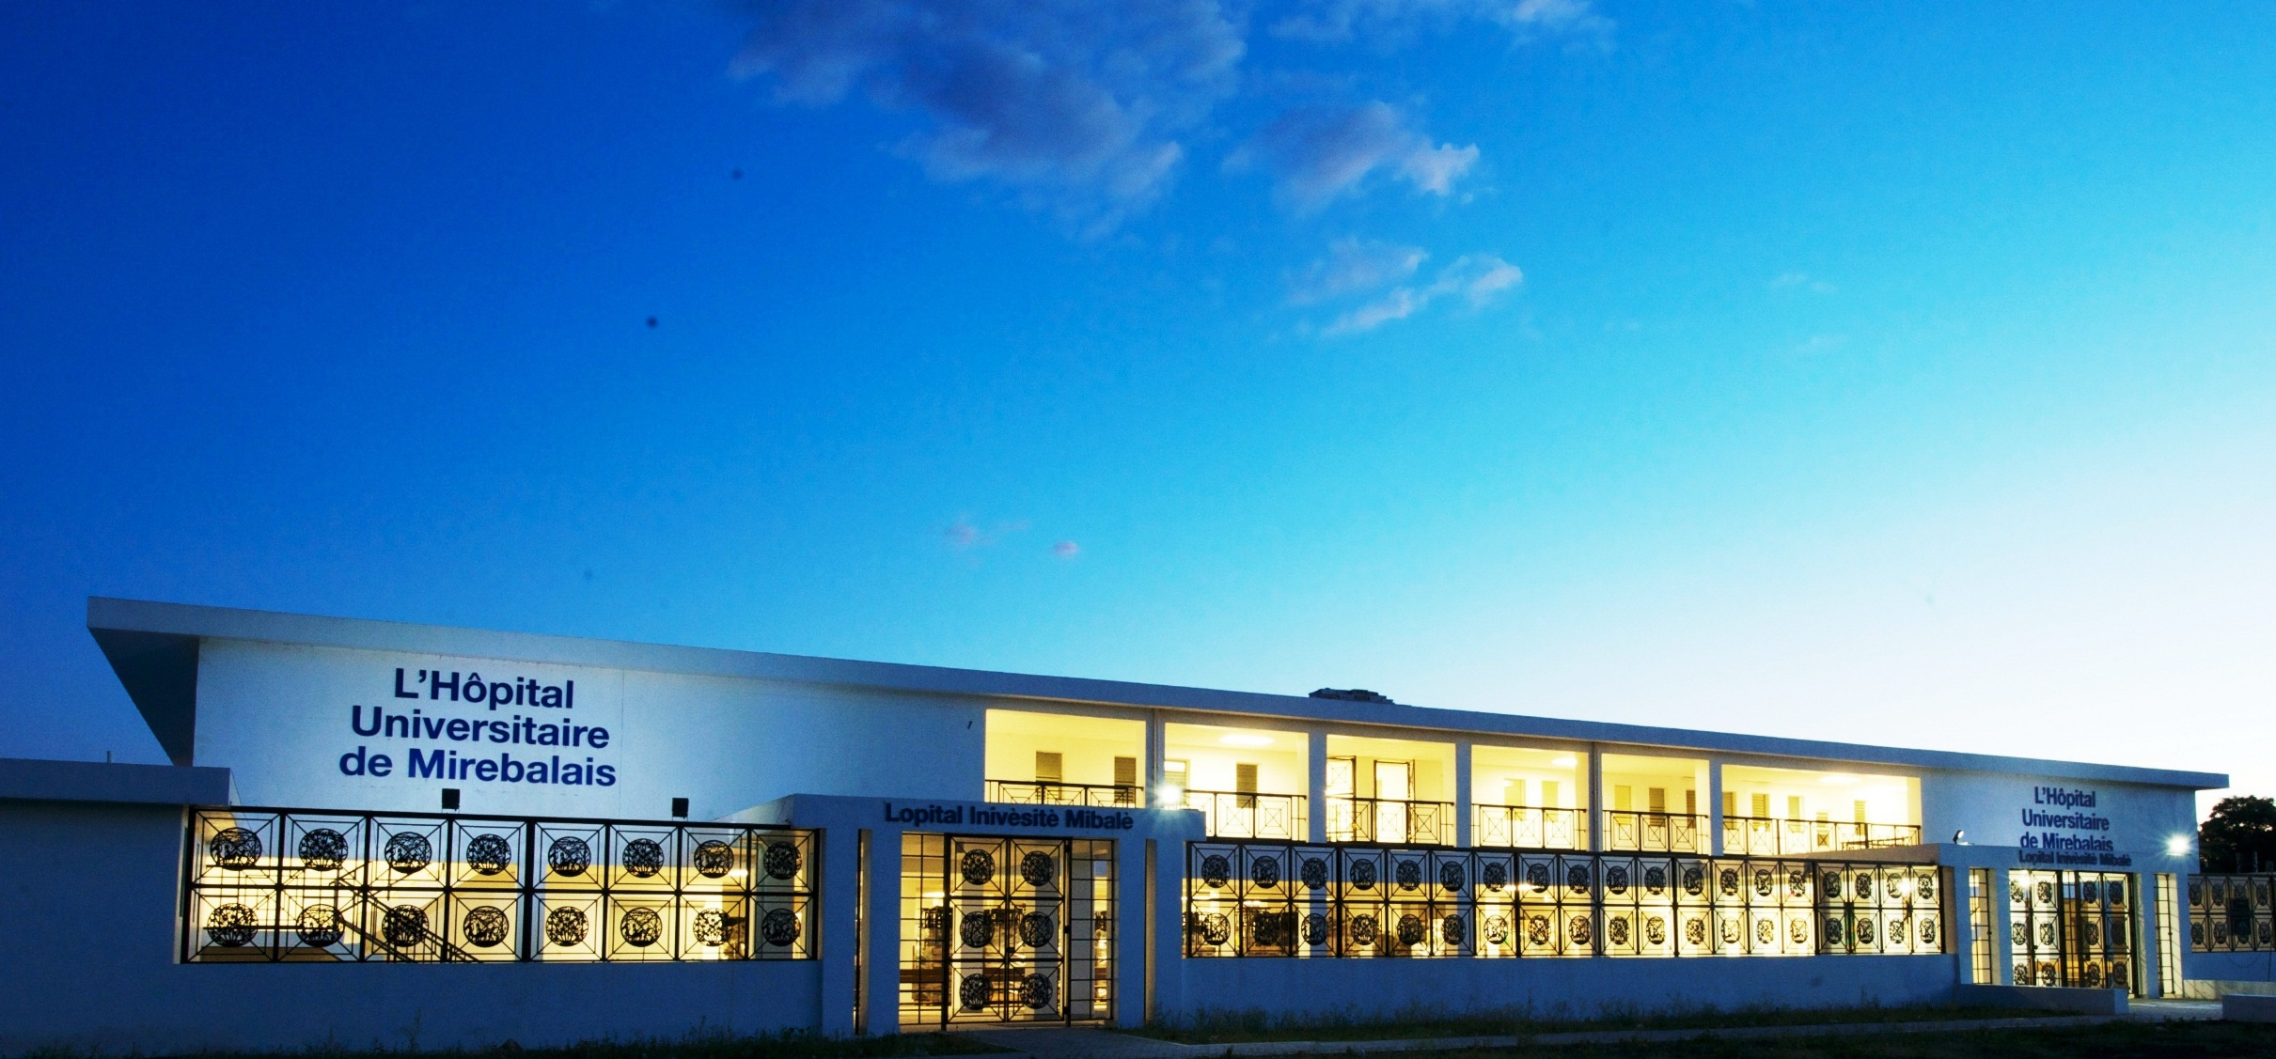
“Who lives and who dies depends
on staff, space, stuff, and systems.”
-Dr. Paul Farmer

Slide 32
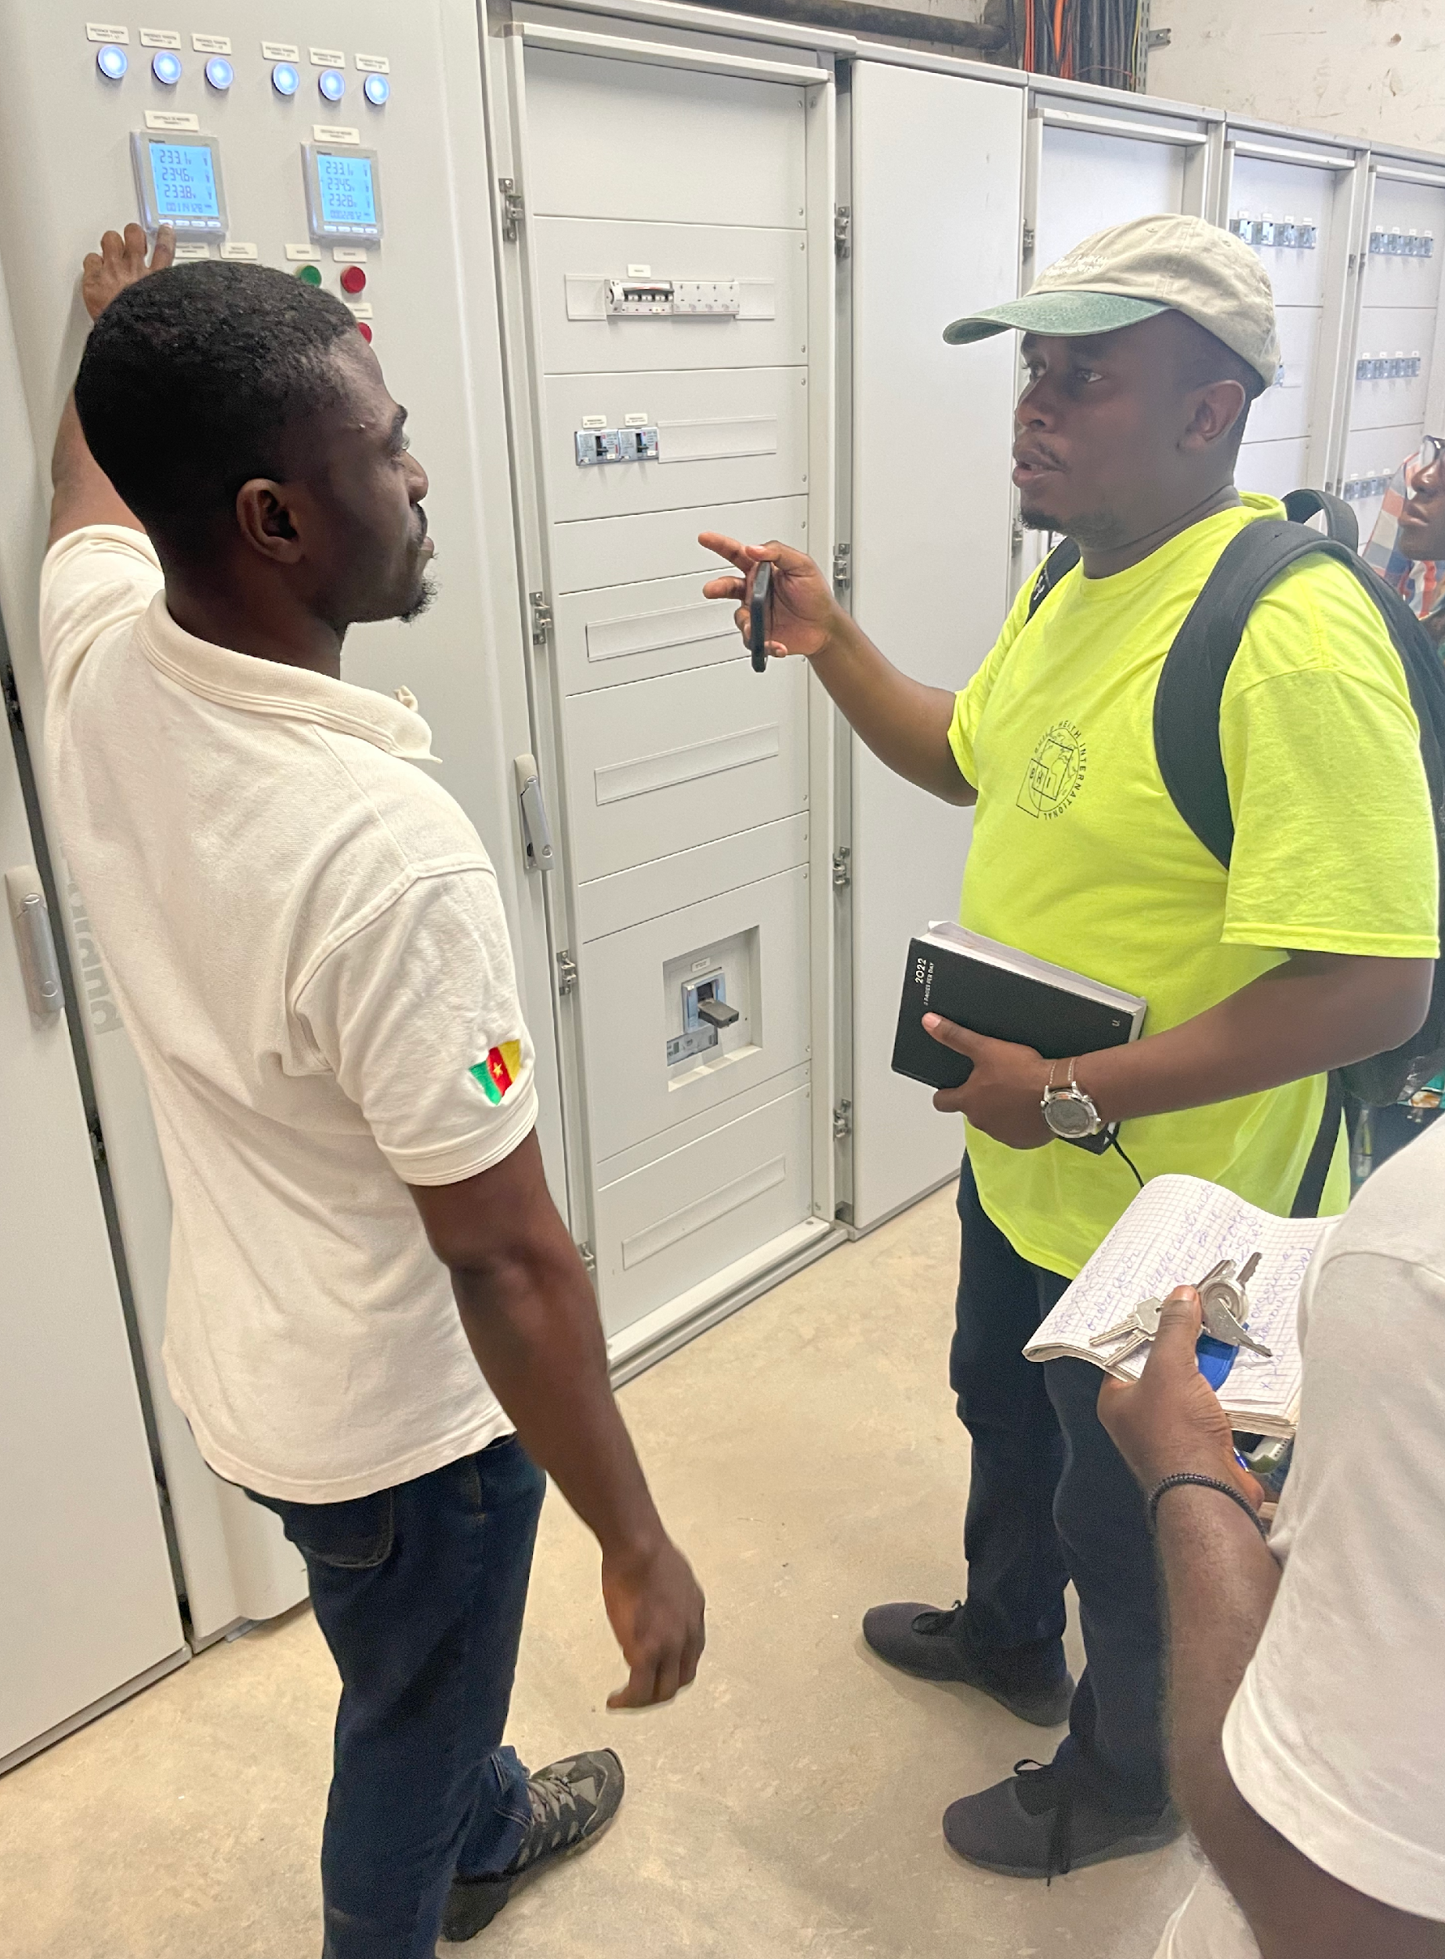
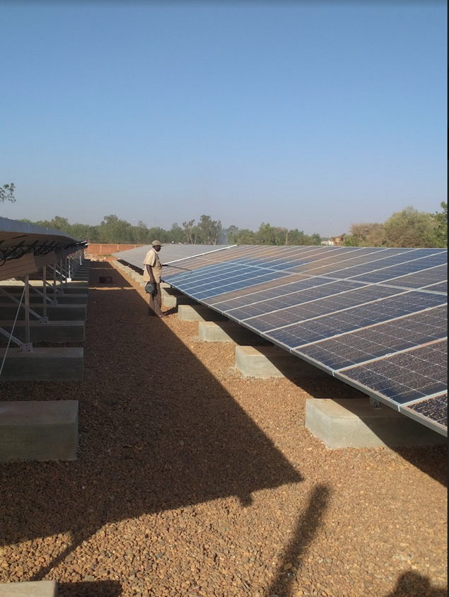
Questions?
Notes:
--highlight challenges of PSA complexity--

