Slide 1
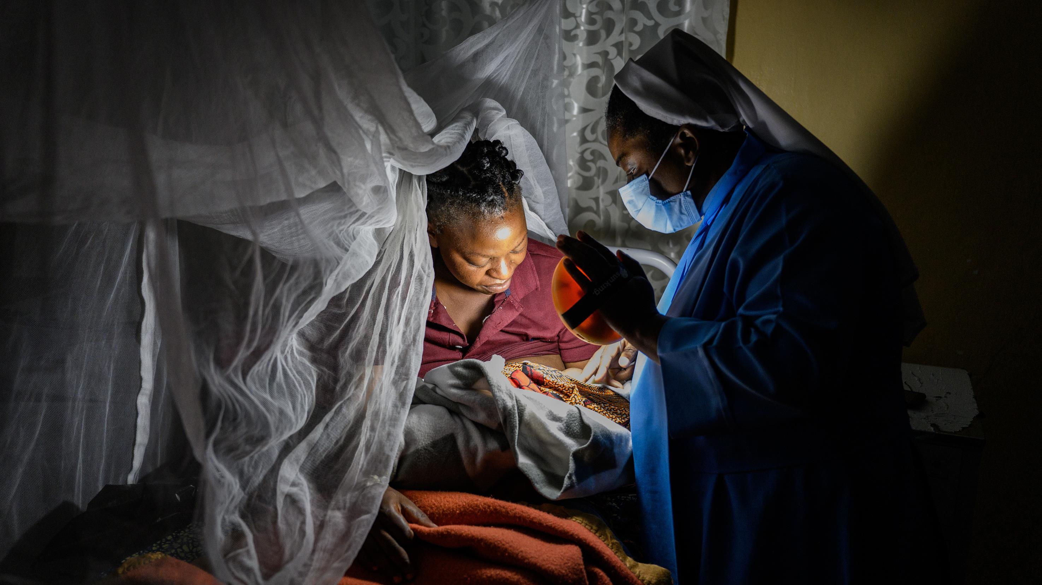

solar powering
Healthcare

Slide 2
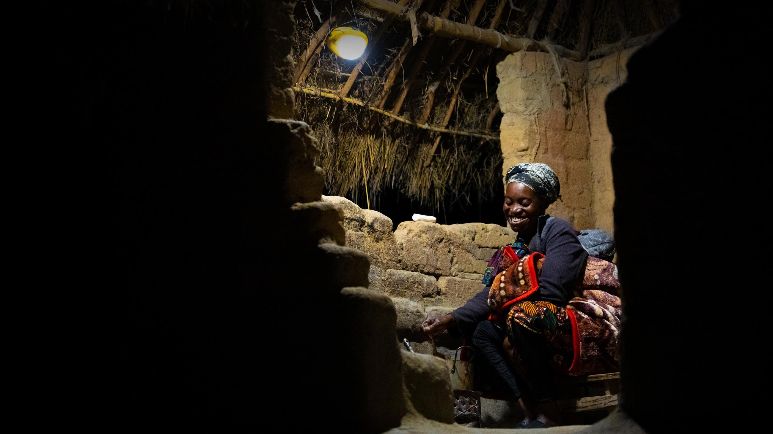
about us
Notes:
Founded in 2006
Distributing solar lights to homes, schools and clinics in sub-Saharan Africa.

Slide 3
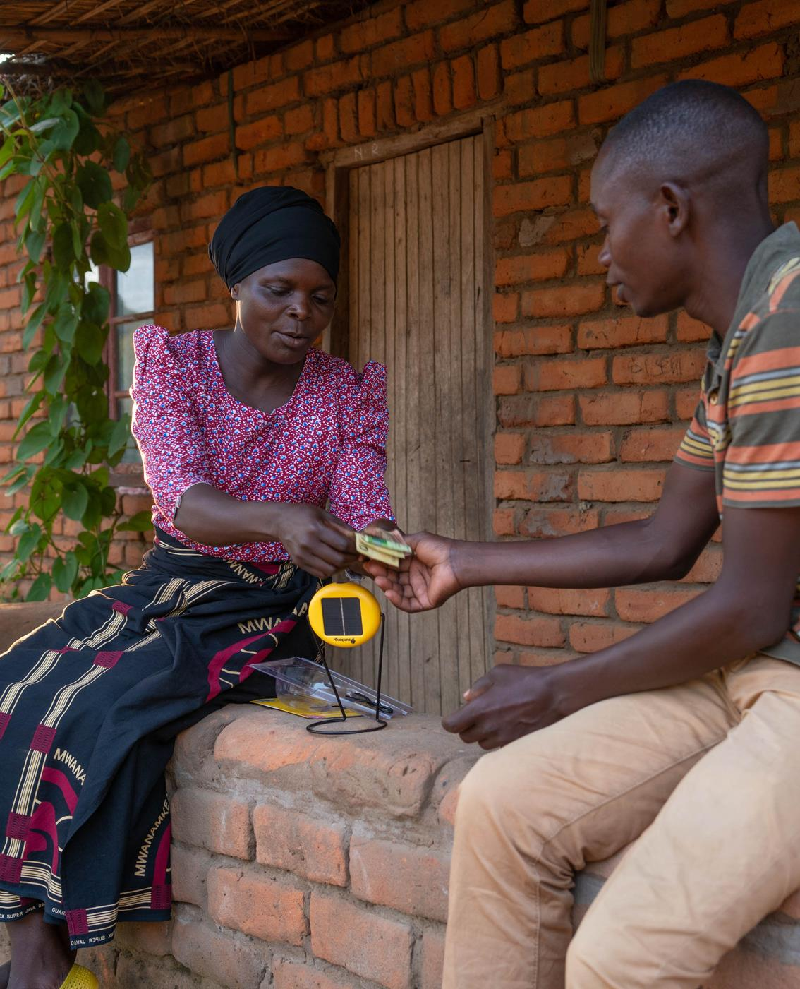
charity + business

Slide 4
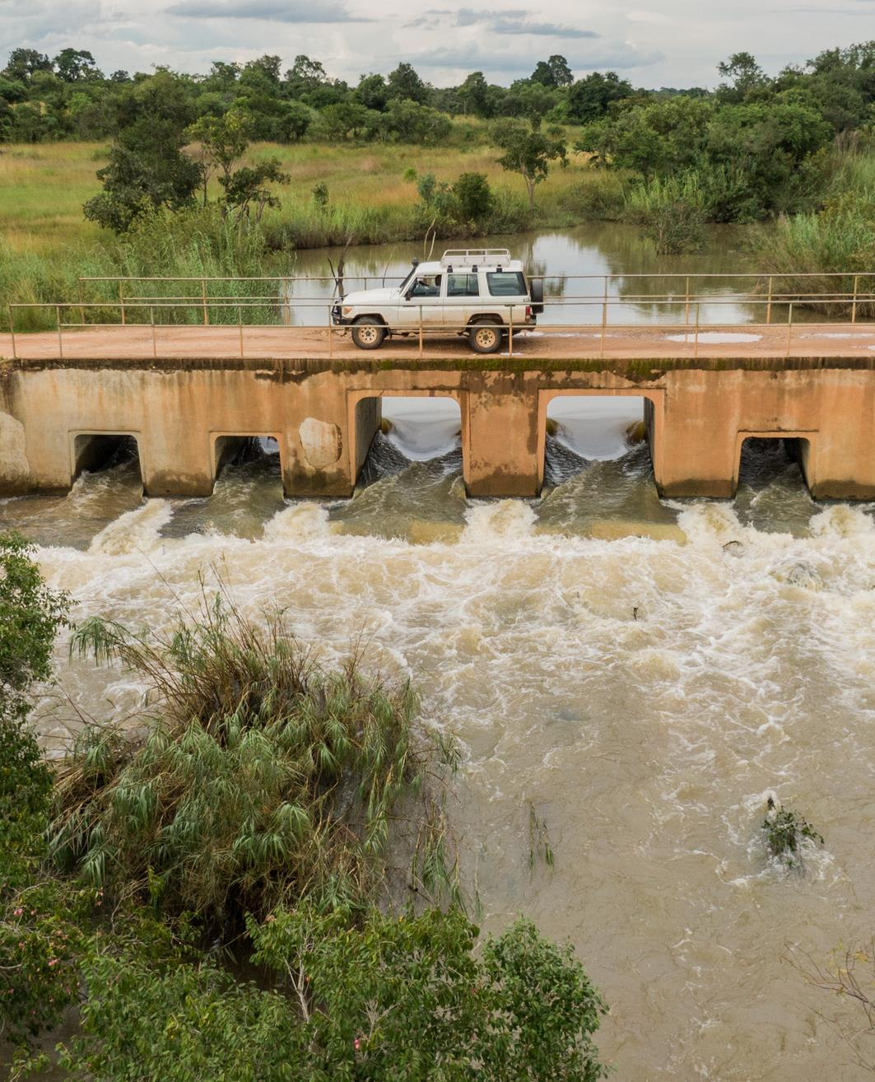
innovation to
Bridge the gap

Slide 5
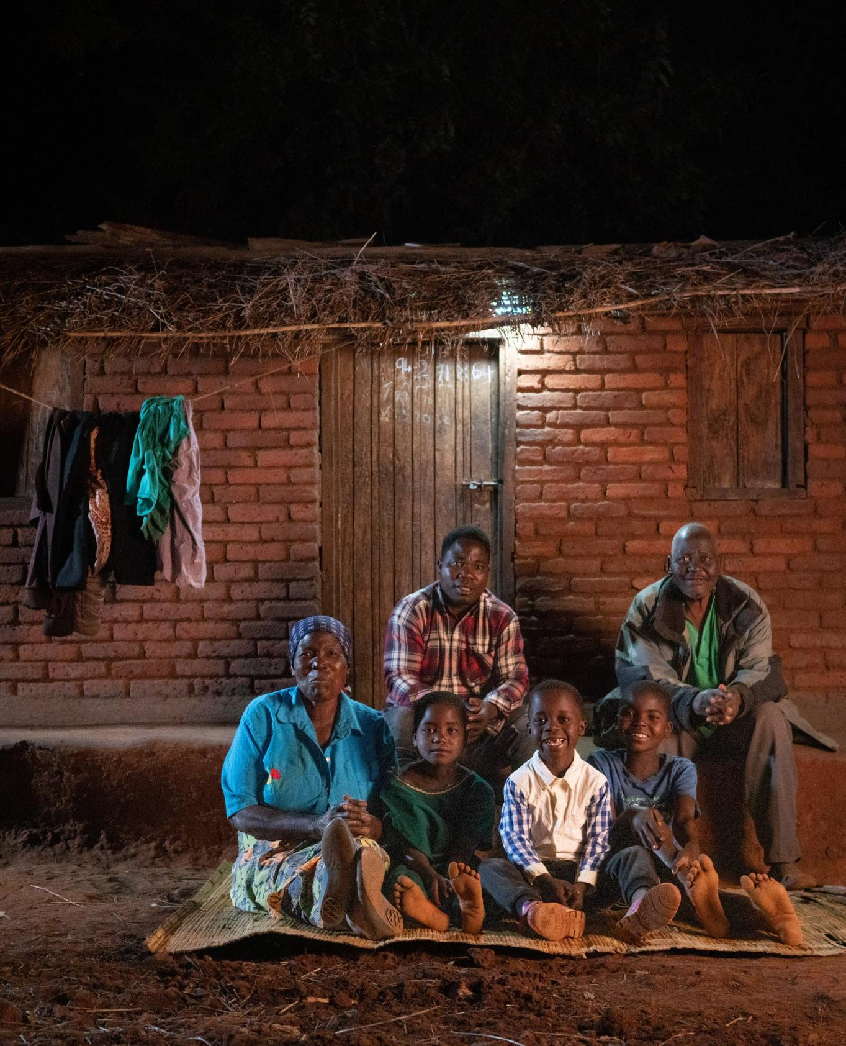
To date : 2.2m solar lights
distributed

Slide 6
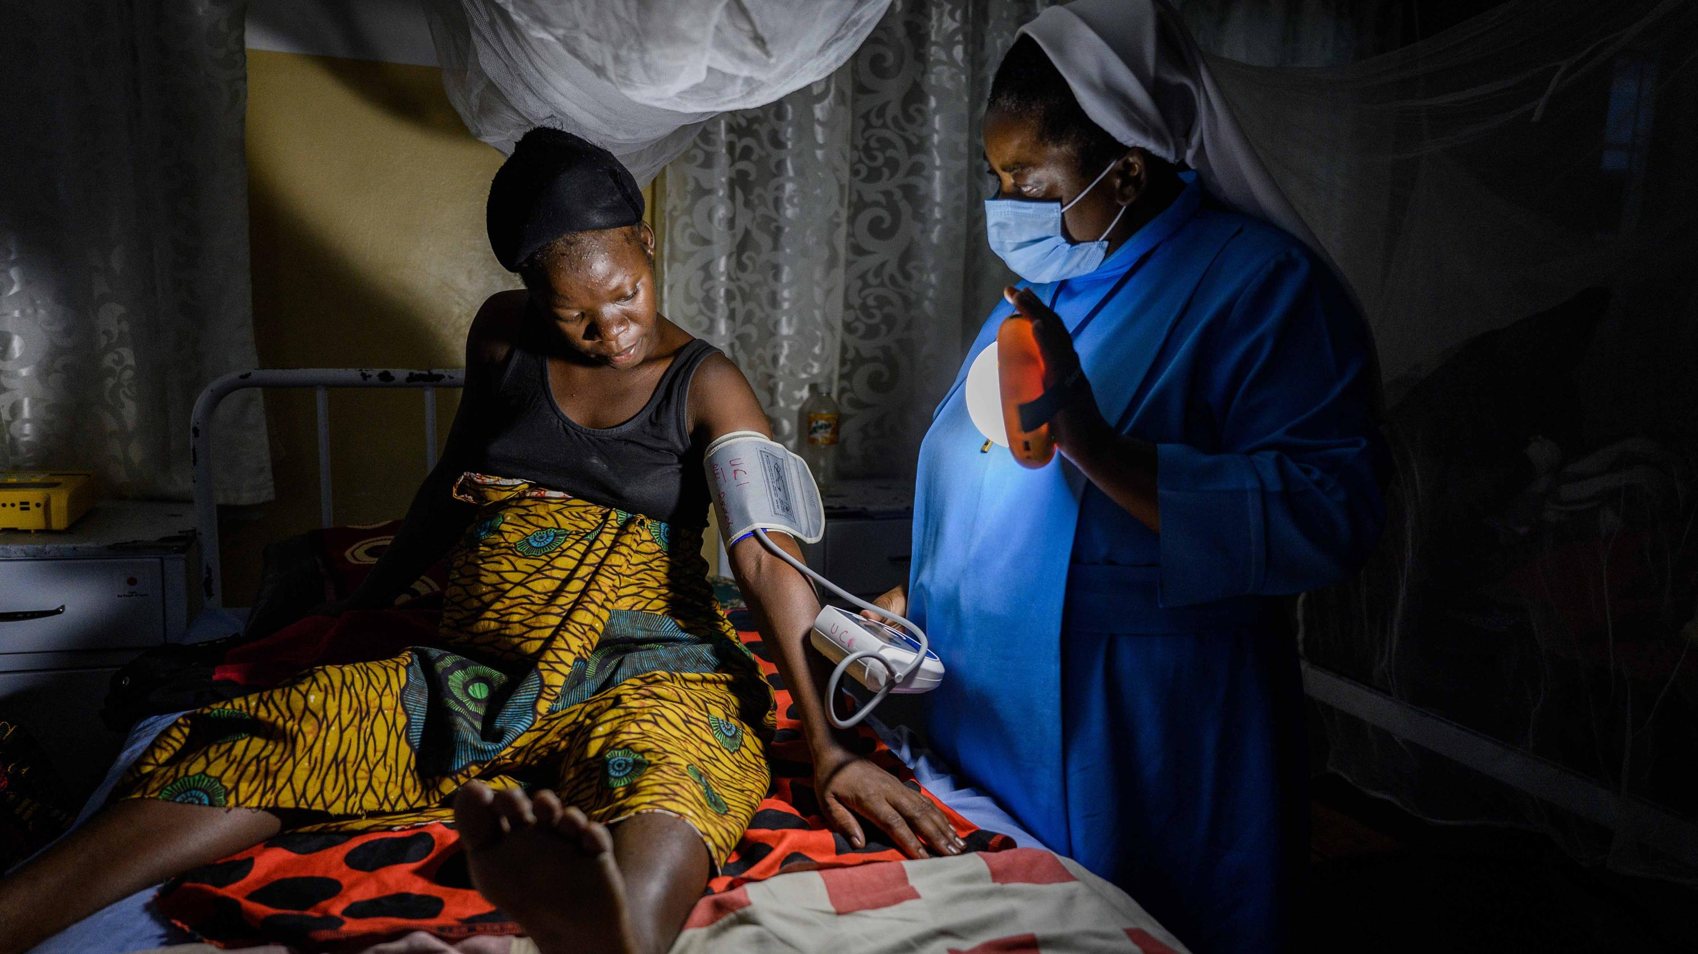
solar powering healthcare
Notes:
We are pleased to be here today to share our learnings when it comes to equipping rural health centres with solar, as a large part of our strategy as an organisation is to be Open Source. Do. Learn. Share. - that is how we believe we can find solutions to some of the greatest problems we are currently facing. We therefore also welcome anyone to get in touch with us after this webinar, if you have any questions or would like to discuss possible joint work.

Slide 7
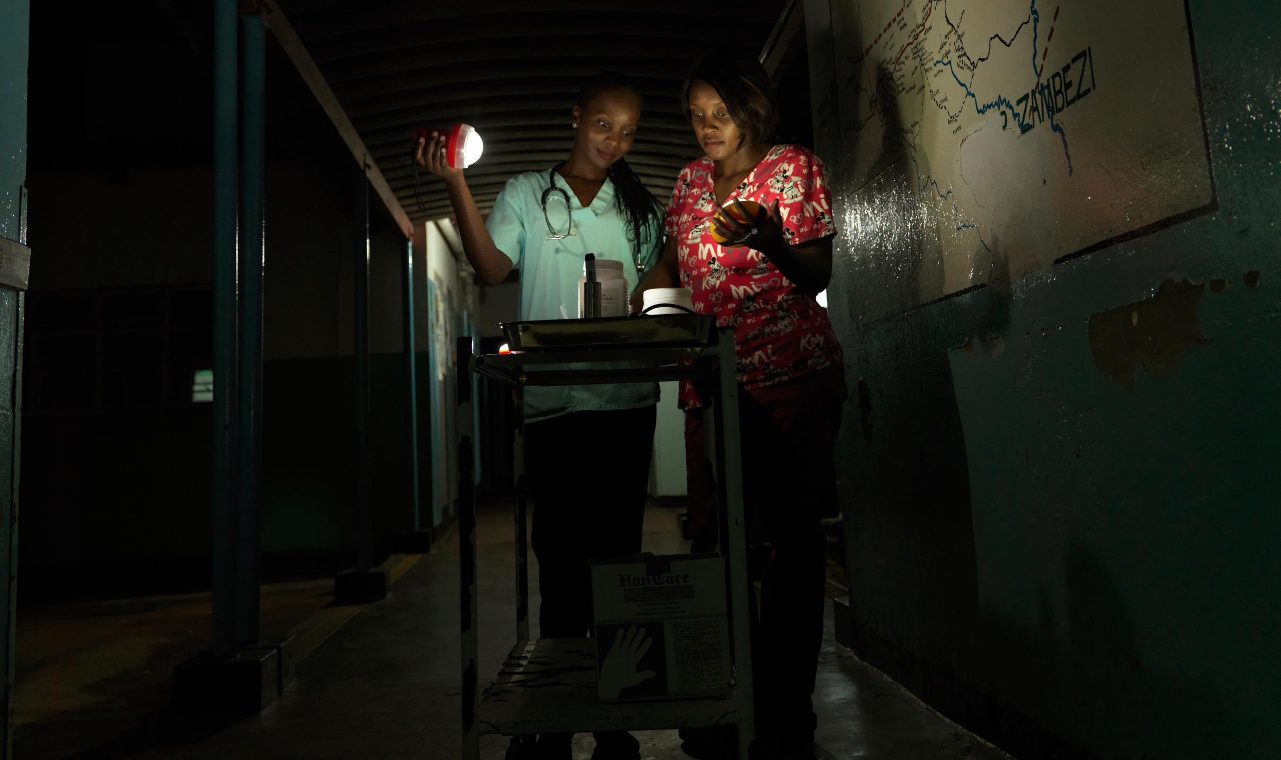
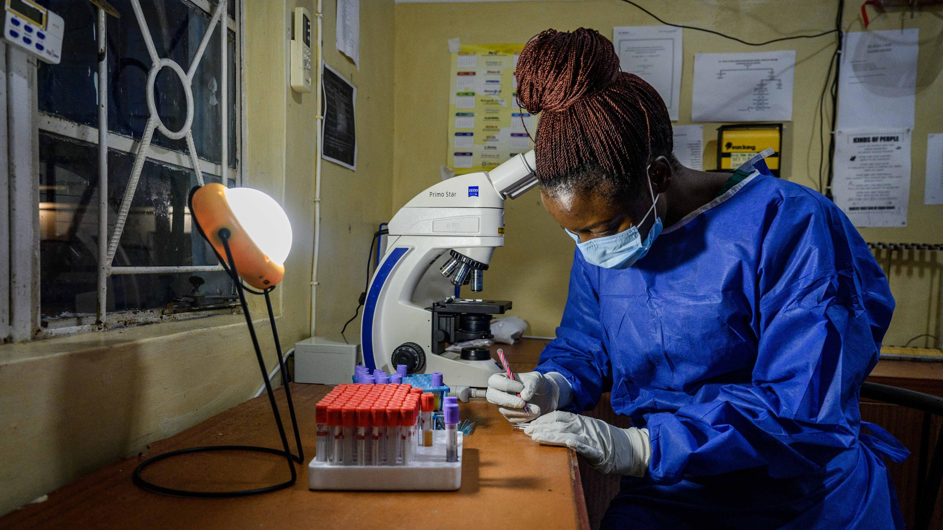
415 installations

Slide 8
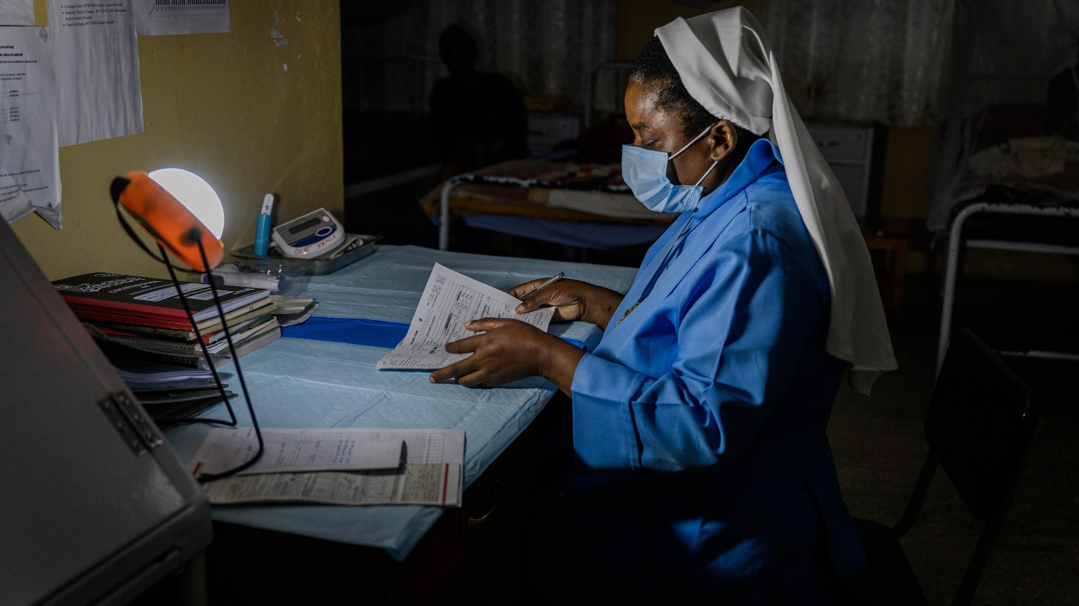
2020
covid19 - rapid deployment

Slide 9
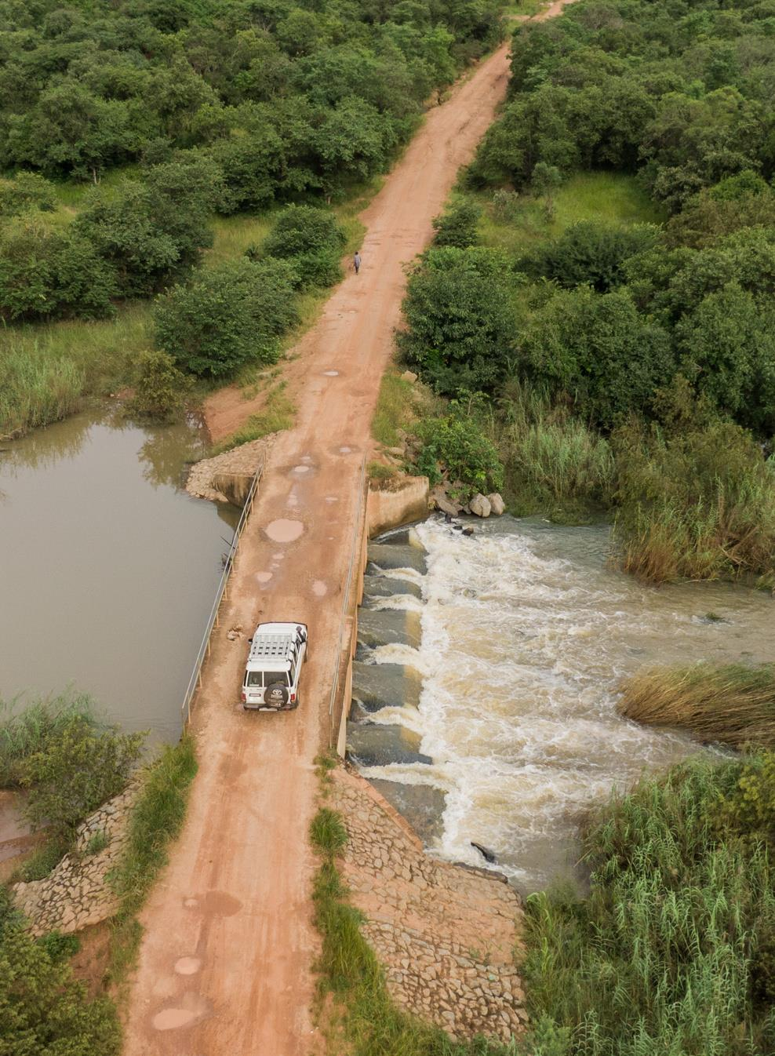
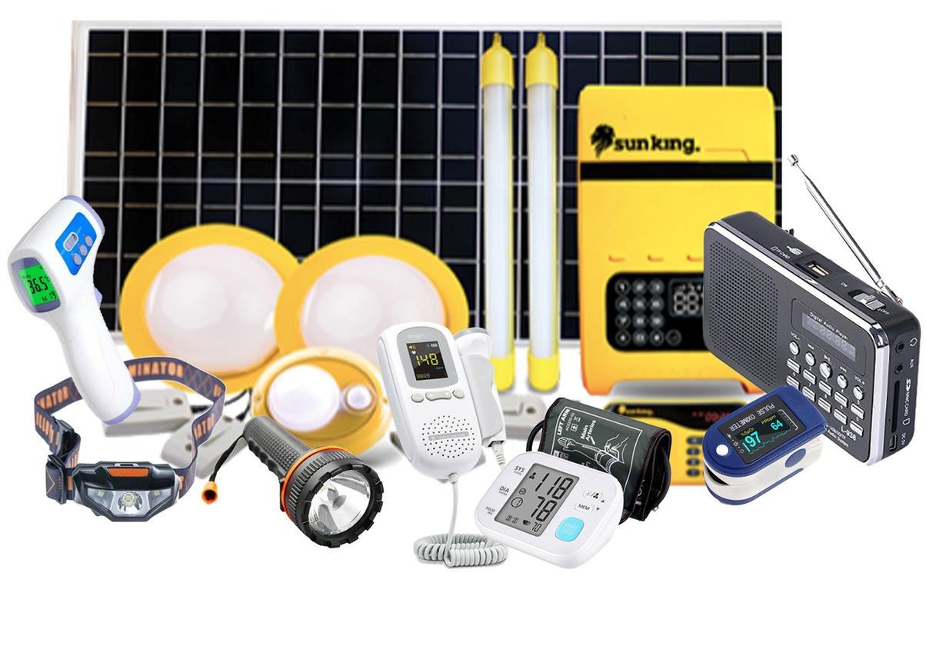
Plug and Play Solar

Slide 10
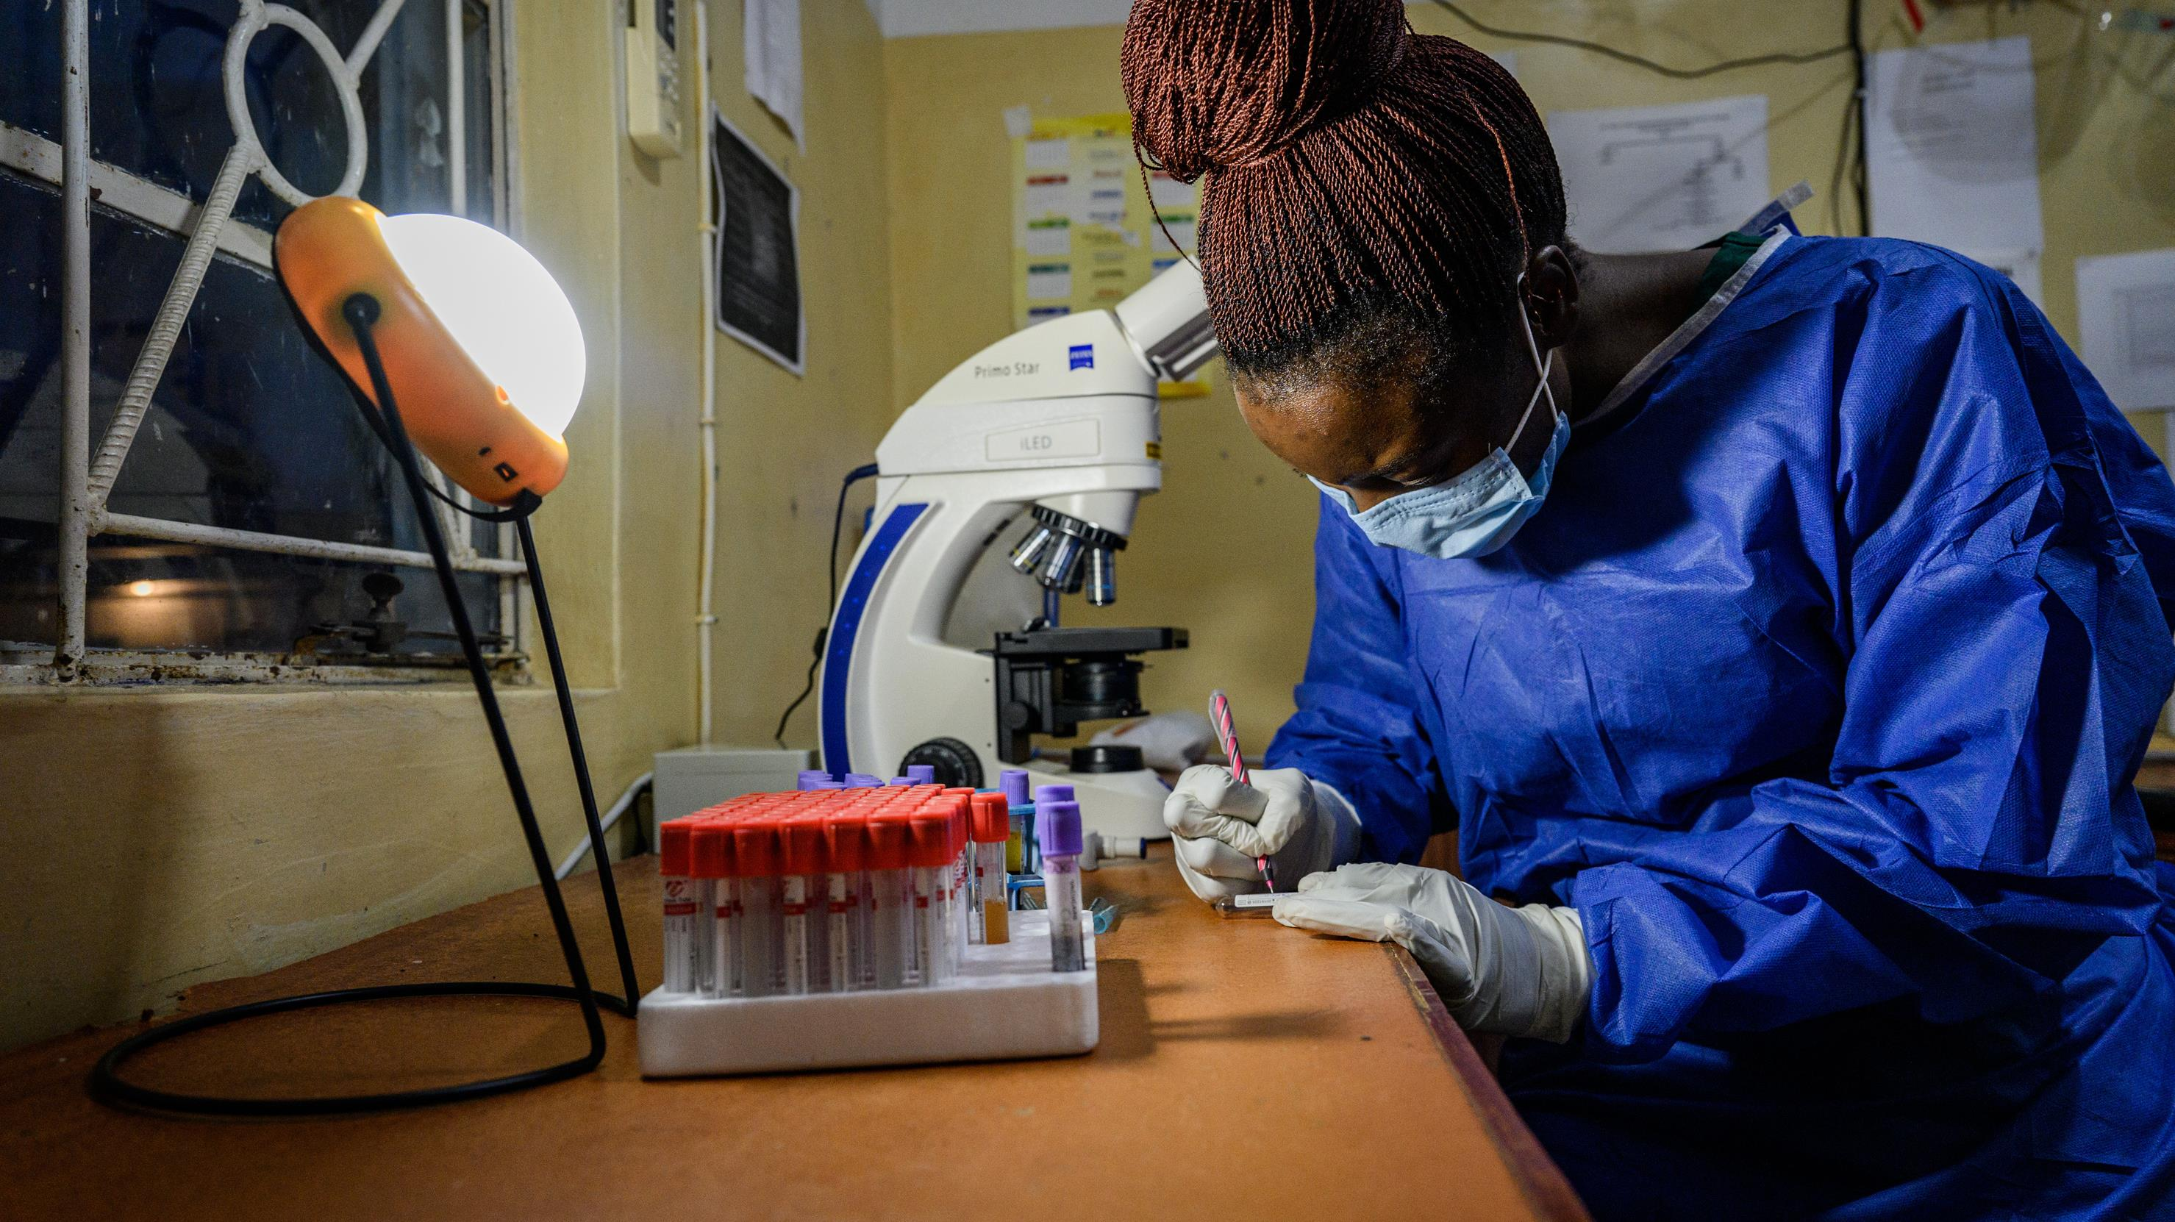
learnings:
challenges &
opportunities

Slide 11
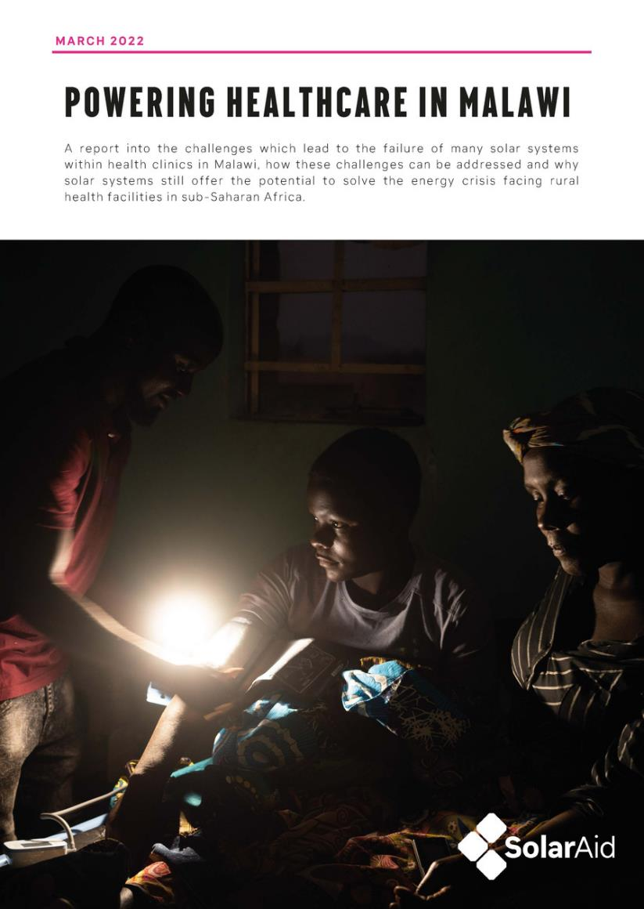
CHALLENGES
too many systems fail
Our own research together with Mzuzu University, Malawi (2021), showed a staggering 87.5% of health facilities had solar systems which had either failed completely or were underperforming
When a system fails:
  Who knows?
  Who trouble shoots?
  Who is responsible?
  Who pays?
  Who repairs?

Slide 12
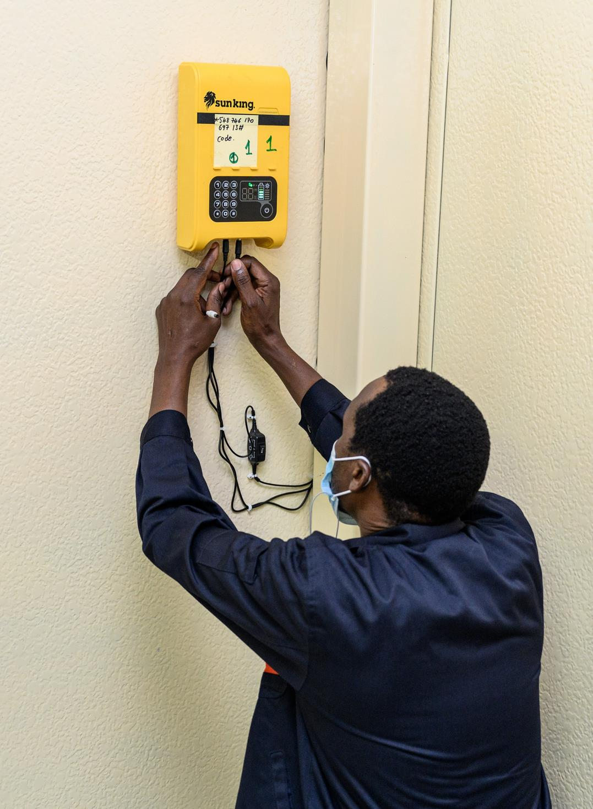
CHALLENGES
Maintenance

Slide 13
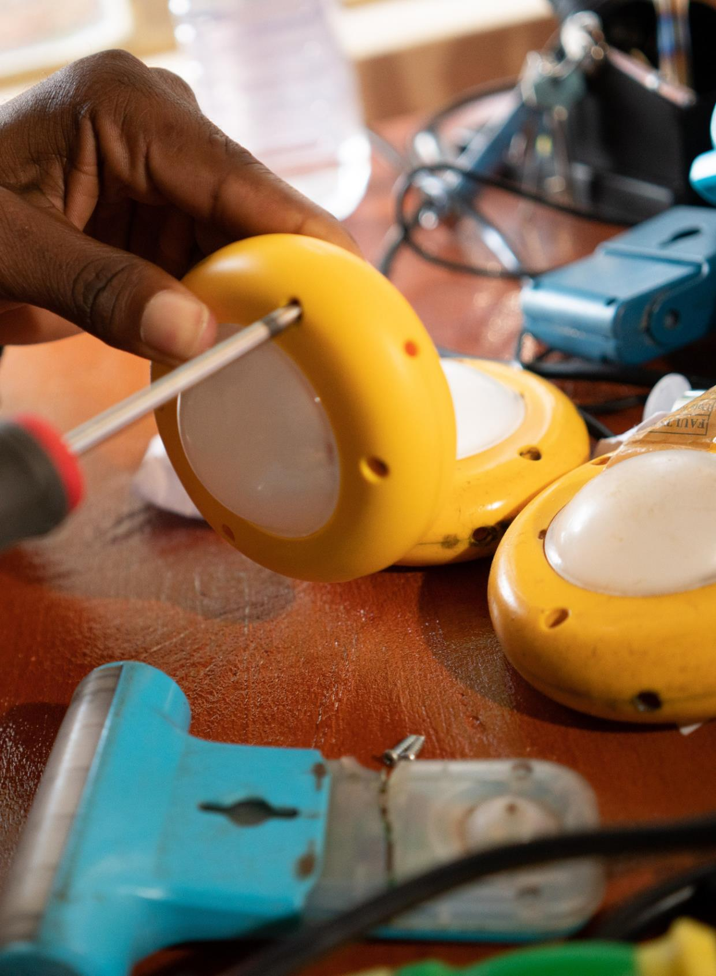
CHALLENGES
lack of access
  Spare parts
  Trained technicians

Slide 14
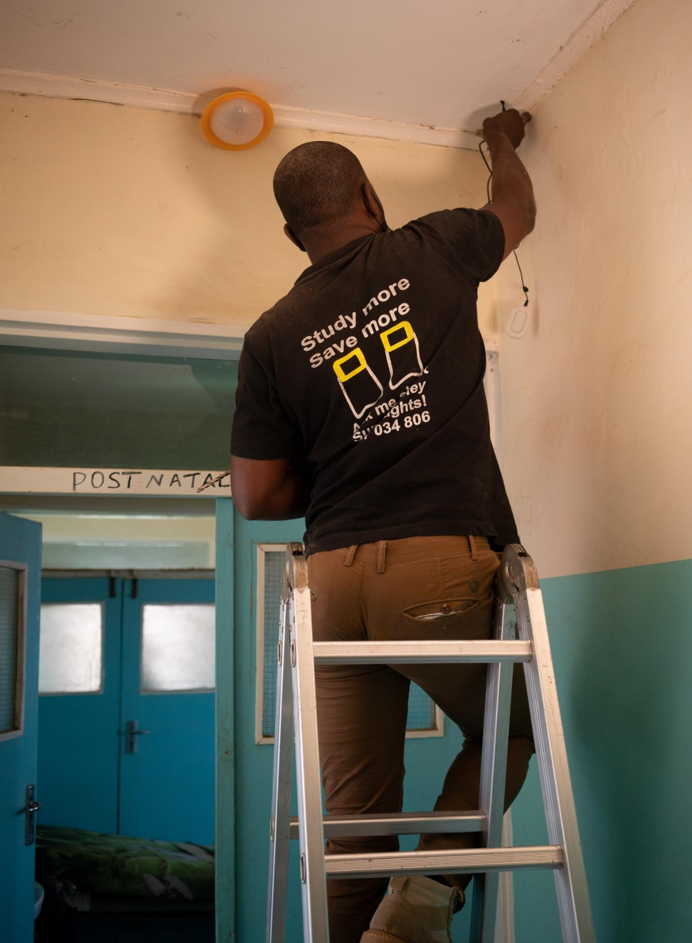
CHALLENGES
responsibility
  Lack of coordination
  Lack of ownership

Slide 15
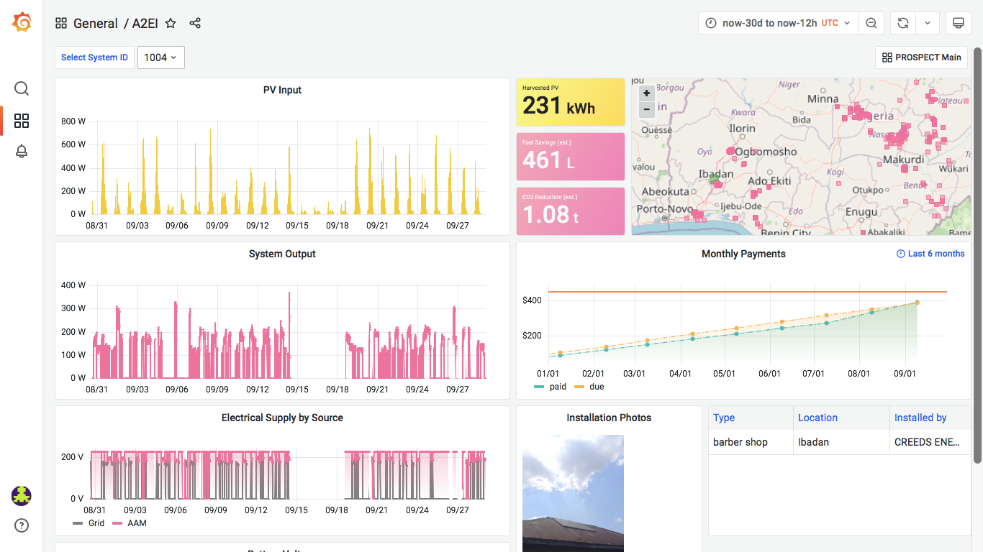
OPPORTUNITIES
Online tracking & coordination systems

Slide 16
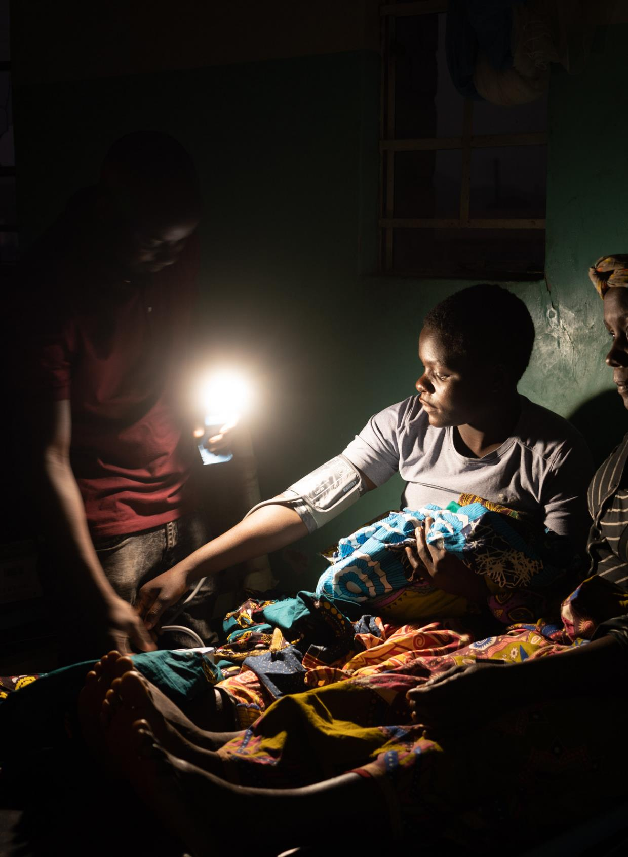
OPPORTUNITIES
understanding energy needs

Slide 17
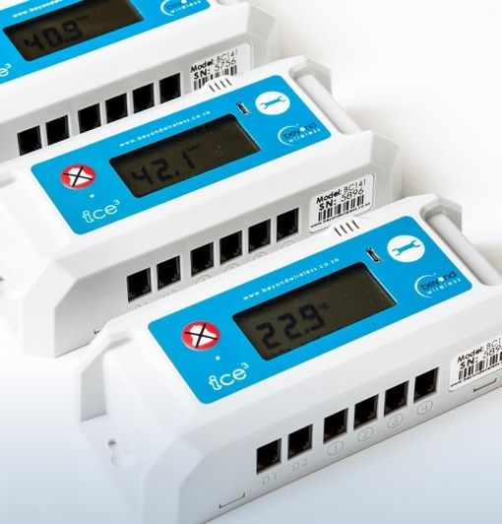
OPPORTUNITIES
remote monitoring + support

Slide 18

OPPORTUNITIES
Plug and play
  Lower costs
  Energy efficient
  Rapid deployment
  Maintenance free
Possible interim solution

Slide 19
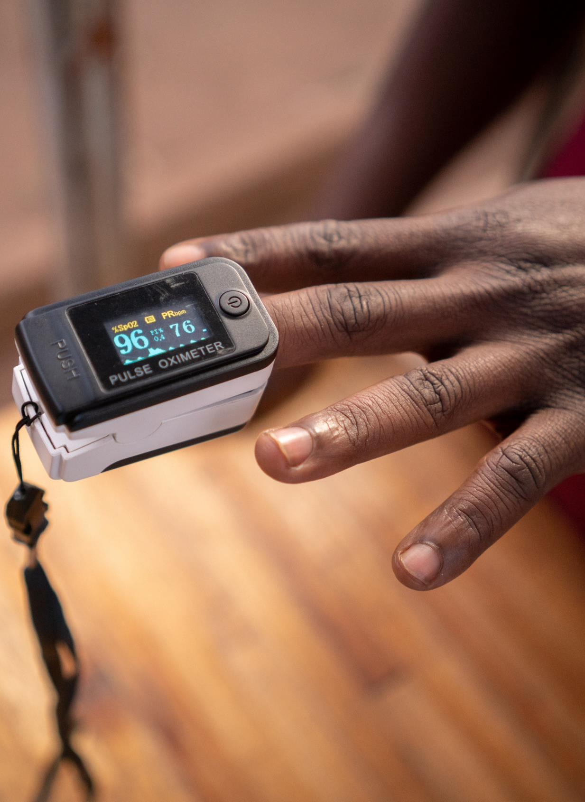
OPPORTUNITIES
Efficient medical appliances and lighting

Slide 20
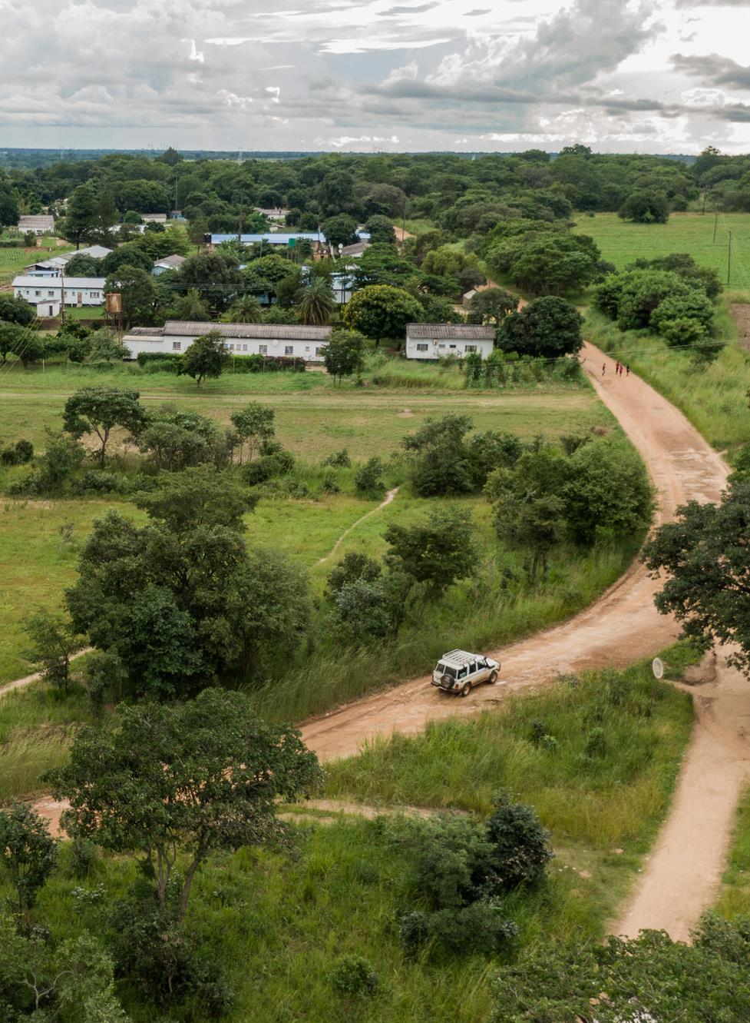
OPPORTUNITIES
smart Solar companies now across Africa
  Maintenance / support
  Spares & repair
  Service models

Slide 21
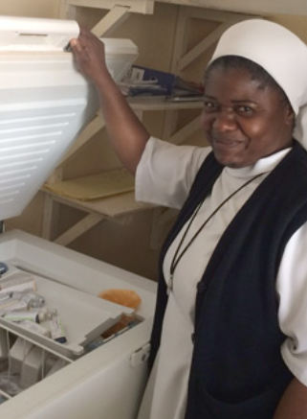
OPPORTUNITIES
refrigeration
Improving technology & affordability

Slide 22
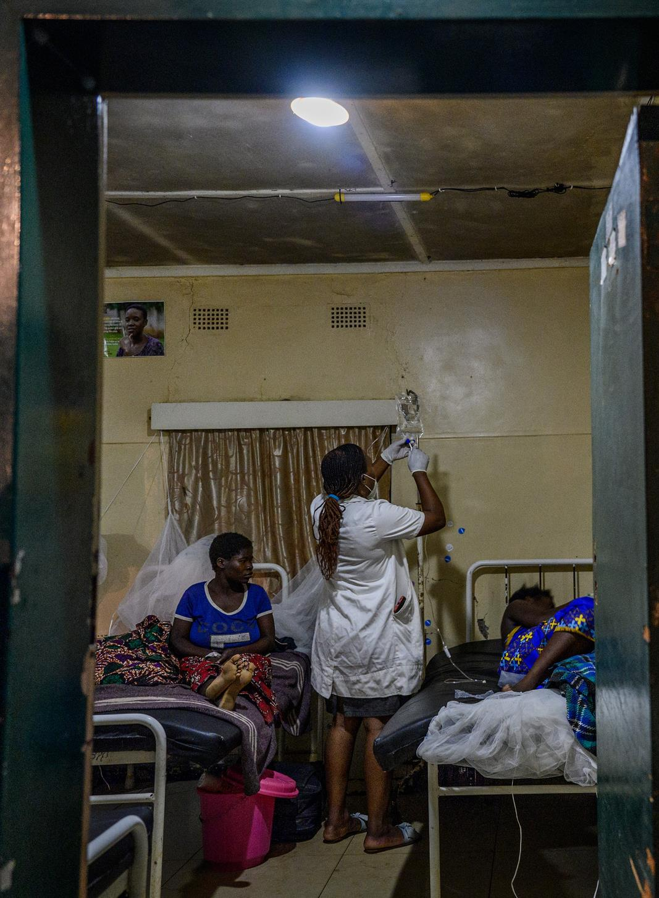
OPPORTUNITIES
finance still a problem, but...
  Business Models needed
  Energy as a service potential
  Low cost finance
  Subsidy potential

Slide 23

thank you.
Get in touch:
john.keane@solar-aid.org

